Slide 1
Exactus Summer School "Modern statistical methods for natural scientists"
Oulu 1.-5.9.2014
Lecture Notes by Elja Arjas

Slide 2
Understanding the meaning of ‘randomness’, or ‘uncertainty’, from different perspectives
Cowan’s Lecture 1, slide 5:
In particle physics there are various elements of uncertainty:
theory is not deterministic: quantum mechanics
random measurement errors:
present even without quantum effects
things we could know in principle but don’t
e.g. from limitations of cost, time, ...
We can quantify the uncertainty using PROBABILITY

Slide 3
Understanding the meaning of ‘randomness’, cont’d:
Cowan’s Lecture 1, slide 13: Frequentist Statistics − general philosophy
In frequentist statistics, probabilities are associated only with the (potentially observable, future) data, i.e., outcomes of repeatable observations. Probability = ‘limiting frequency’.
Probabilities such as P(Higgs boson exists), P (0.117 < α s < 0.121), etc. are either 0 or 1, but we don’t know which. Not so, in my view: There is no frequentist concept of probability for propositions like this!
The tools of frequentist statistics tell us what to expect, under the assumption of certain probabilities, about hypothetical repeated observations. The preferred theories (models, hypotheses, ...) are those for which our observations would be considered ‘usual’.

Slide 4
Understanding the meaning of ‘randomness’, cont’d
Cowan’s Lecture 1, slide 8: Interpretation of probability
I. Relative frequency A, B, ... are outcomes of a repeatable experiment
cf. quantum mechanics, particle scattering, radioactive decay...
II. Subjective probability A, B, ... are hypotheses (statements that are true or false)
Both interpretations consistent with Kolmogorov axioms.
In particle physics frequency interpretation often most useful, but subjective probability can provide more natural treatment of non-repeatable phenomena: systematic uncertainties, probability that Higgs boson exists,..

Slide 5
Understanding the meaning of ‘randomness’, cont’d
The interpretations, and attempts to define the concept of probability, range from physical to purely epistemological: ’classical’ based on symmetry (coin tossing, dice throwing, …), ‘propensity’, limiting relative frequency, logical, subjective, …
None of these can actually be used, in the strict mathematical sense, as a definition of probability.
For this, the commonly accepted basis is the set of axioms of Kolmogorov, according to which probability is a countably additive measure of total mass 1. cf. Cowan’s Lecture 1, slide 6.
Notes: sets A, B, … are interpreted as propositions with truth values 0 and 1, and the operations/relationships between them are understood to mean: ∩ = ‘and’, U = (disjunctive) ‘or’, c = ‘implies’.

Slide 6
Understanding the meaning of ‘randomness’, cont’d
Thus, for example, if A and B cannot both be true (formally: A ∩ B = ф), then
P(A U B) = P(A) + P(B).
Also, if A implies B, then P(A) ≦ P(B).

Slide 7
Understanding the meaning of ‘randomness’, cont’d
(Excerpt from Olli Saarela’s home page:)
… The mathematical (measure-theoretical) axiomatic definition of probability is free of interpretations.
In contrast to mathematicians, due to the applied nature of the field, the interpretation or essence of probability is a topic on which every statistician has to form some kind of stance. This in turn tends to divide statisticians into various quarrelling factions.

Slide 8
Understanding the meaning of ‘randomness’, cont’d
… According to the subjective/epistemic interpretation of probability, probabilities are interpreted as measures of information.
"Probability as degree of belief is surely known by anyone: it is that feeling which makes him more or less confident or dubious or sceptical about the truth of an assertion, the success of an enterprise, the occurrence of a specific event whatsoever, and that guides him, consciously or not, in all his actions and decisions.“ (de Finetti, 1974, p. 122).

Slide 9
Understanding the meaning of ‘randomness’, cont’d
"In our terminology, a probability is something that we assign, in order to represent a state of knowledge, or that we calculate from previously assigned probabilities according to the rules of probability theory. A frequency is a factual property of the real world that we measure or estimate. The phrase 'estimating a probability' is just as much a logical incongruity as 'assigning a frequency' or 'drawing a square circle'.
The fundamental, inescapable distinction between probability and frequency lies in this relativity principle: probabilities change when we change our state of knowledge; frequencies do not .“
(Jaynes 2003, p. 292)
Jaynes, himself a physicist, thinks that the idea of objectively existing ‘physical’ probabilities is an example of human ‘projection fallacy’. Jaynes also wants to say ‘probability for …’, instead of ‘probability of …’.

Slide 10
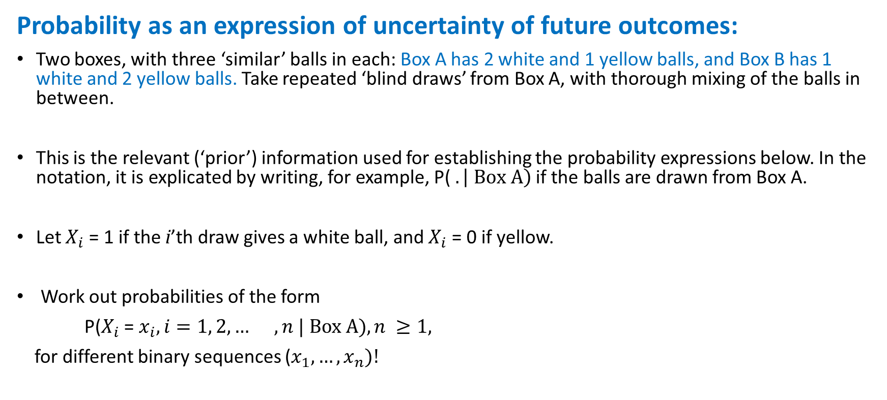
A simple demonstration: balls in boxes
Probability as an expression of uncertainty of future outcomes:
Two boxes, with three ‘similar’ balls in each: Box A has 2 white and 1 yellow balls, and Box B has 1 white and 2 yellow balls. Take repeated ‘blind draws’ from Box A, with thorough mixing of the balls in between.
This is the relevant (‘prior’) information used for establishing the probability expressions below. In the notation, it is explicated by writing, for example, P($. \left| Box A\right)$if the balls are drawn from Box A.
Let $X_{i}$ = 1 if the i’th draw gives a white ball, and $X_{i}$ = 0 if yellow.
Work out probabilities of the form
P($X_{i}$ = $x_{i}, i=1, 2,… , n | Box A), n ≥1,$
for different binary sequences ($x_{1}, …, x_{n})!$

Slide 11

Balls in boxes: uncertainty of future outcomes
Consider first $P\left(X_{1}=x_{1}| \text{Box} \text{A}\right)$ and $P\left(X_{1}=x_{1}|\text{Box} \text{B}\right)$.
Discuss the reasons for your choice!

Slide 12
Balls in boxes: uncertainty of future outcomes
Here are some reasons:
knowledge that you were drawing the balls from Box A with known contents;
the symmetry argument ‘each of the three balls is a likely to be drawn as any other’;
two different balls give the result ‘white’;
there is ‘no memory’ (physical, to a sufficient approximation), and the draws are logically independent from each other.

Slide 13
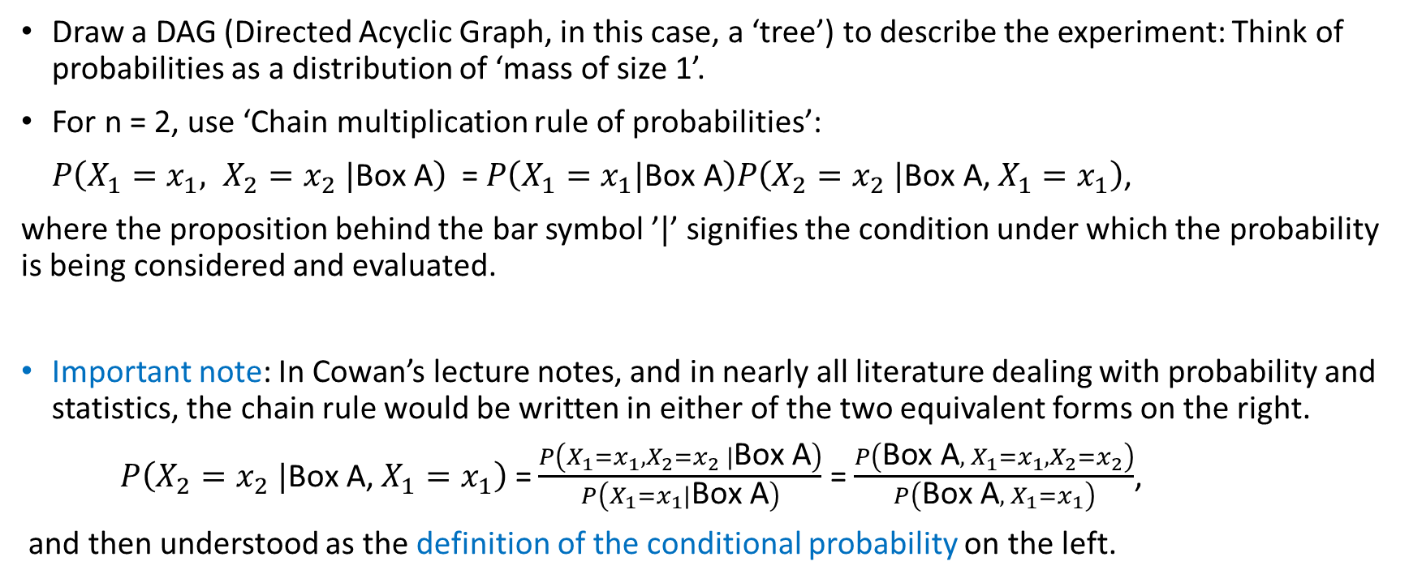
Balls in boxes: uncertainty of future outcomes
Draw a DAG (Directed Acyclic Graph, in this case, a ‘tree’) to describe the experiment: Think of probabilities as a distribution of ‘mass of size 1’.
For n = 2, use ‘Chain multiplication rule of probabilities’:
$P\left(X_{1}=x_{1}, X_{2}=x_{2} |\text{Box} \text{A}\right)$ = $P\left(X_{1}=x_{1}|\text{Box} \text{A}\right)P\left(X_{2}=x_{2} |\text{Box} \text{A}\text{,}{ X}_{1}=x_{1}\right)$,
where the proposition behind the bar symbol ’$|$’ signifies the condition under which the probability is being considered and evaluated.
Important note: In Cowan’s lecture notes, and in nearly all literature dealing with probability and statistics, the chain rule would be written in either of the two equivalent forms on the right.
$P\left(X_{2}=x_{2} |\text{Box} \text{A}\text{,}{ X}_{1}=x_{1}\right)$ = $\frac{P\left(X_{1}=x_{1}, X_{2}=x_{2} |\text{Box} \text{A}\right)}{P\left(X_{1}=x_{1}|\text{Box} \text{A}\right)}$ = $\frac{P\left(\text{Box} \text{A}, { X}_{1}=x_{1}, X_{2}=x_{2}\right)}{P\left(\text{Box} \text{A}, { X}_{1}=x_{1}\right)}$,
and then understood as the definition of the conditional probability on the left.

Slide 14
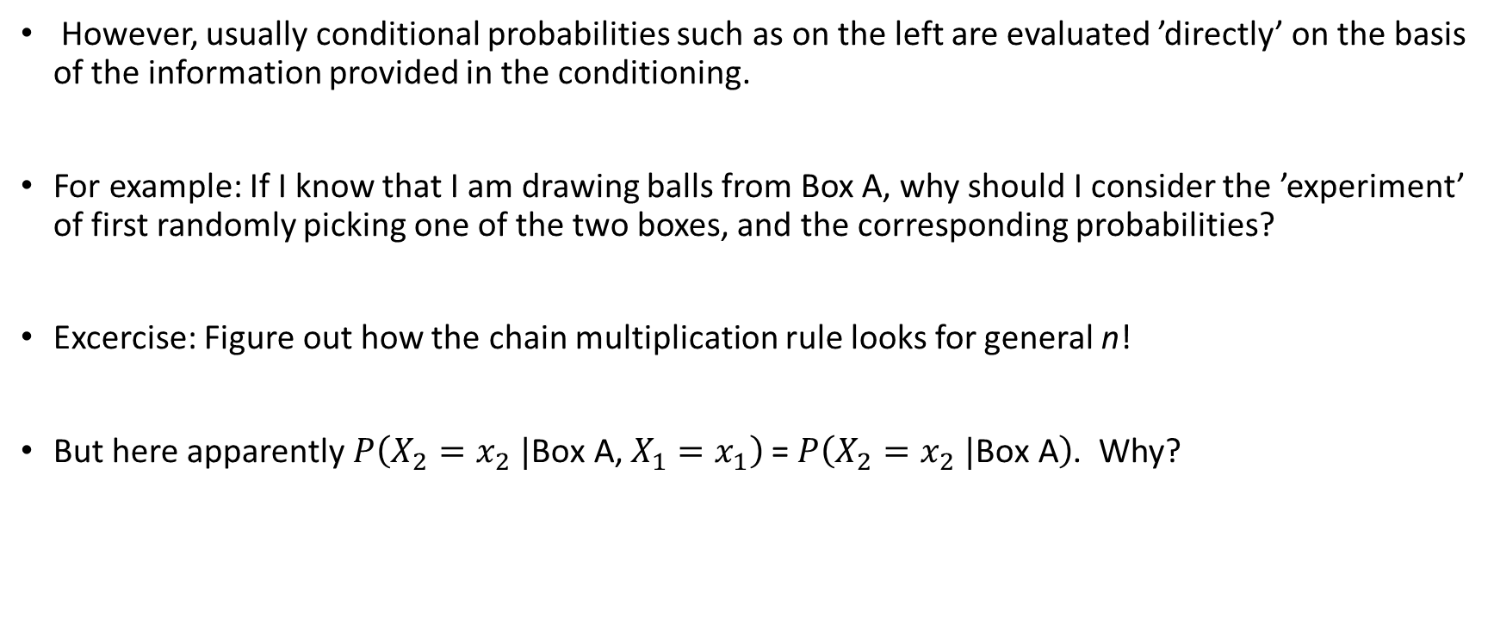
Balls in boxes: uncertainty of future outcomes
However, usually conditional probabilities such as on the left are evaluated ’directly’ on the basis of the information provided in the conditioning.
For example: If I know that I am drawing balls from Box A, why should I consider the ’experiment’ of first randomly picking one of the two boxes, and the corresponding probabilities?
Excercise: Figure out how the chain multiplication rule looks for general n!
But here apparently$P\left(X_{2}=x_{2} |\text{Box} \text{A}\text{,}{ X}_{1}=x_{1}\right)$ = $P\left(X_{2}=x_{2} |\text{Box} \text{A}\right)$. Why?

Slide 15

Balls in boxes: uncertainty of future outcomes
Here the desired general result is:
P($X_{i}$ = $x_{i}, i=1, 2, …, n \left|Box A\right)$ = $\prod_{1}^{n}{P\left(X_{i}=x_{i} |\text{Box} \text{A}\right)=}{(\frac{2}{3})}^{Σx_{i}}{(\frac{1}{3})}^{n−Σx_{i}}$.

Slide 16
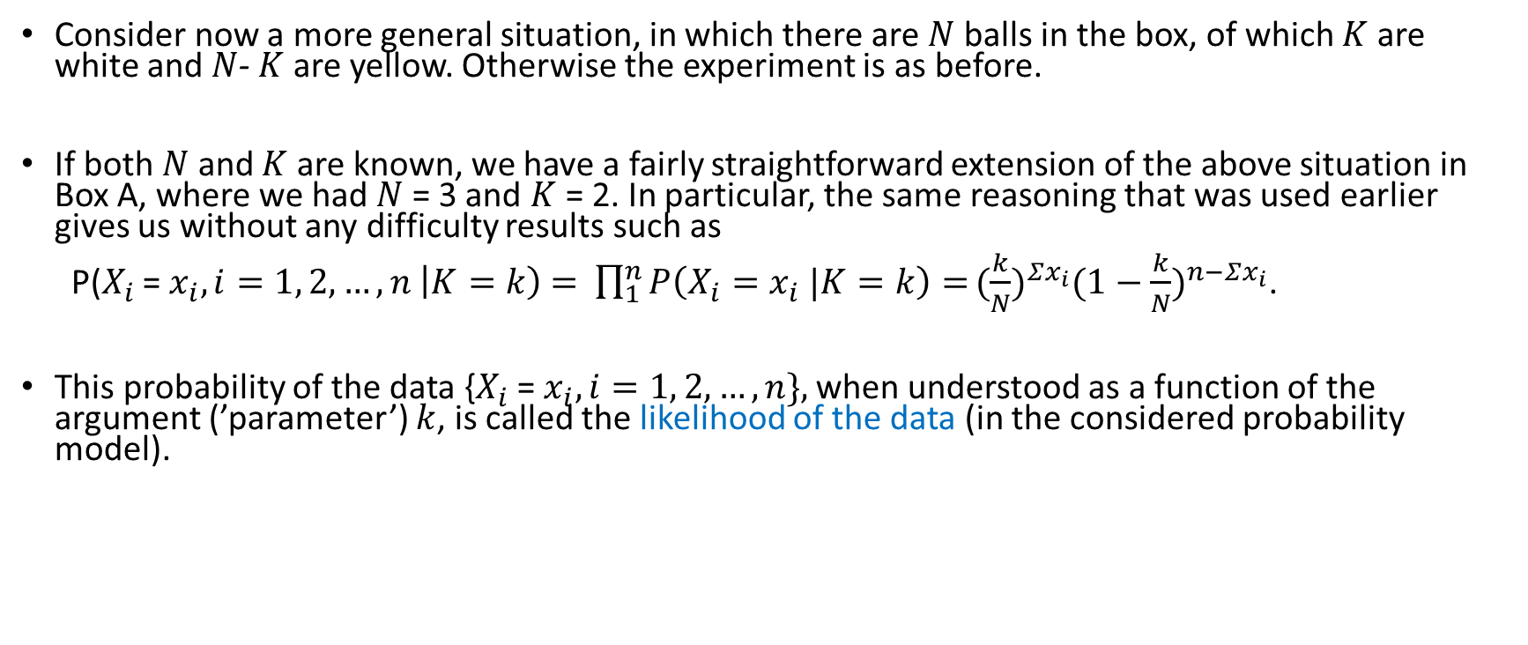
Balls in boxes: more general expressions
Consider now a more general situation, in which there are $N$balls in the box, of which $K$ are white and $N$- $K$ are yellow. Otherwise the experiment is as before.
If both $N$ and $K$ are known, we have a fairly straightforward extension of the above situation in Box A, where we had $N$= 3 and $K$= 2. In particular, the same reasoning that was used earlier gives us without any difficulty results such as
P($X_{i}$ = $x_{i}, i=1, 2, …, n \left|K=k\right)$ = $\prod_{1}^{n}{P\left(X_{i}=x_{i} |K=k\right)=}{(\frac{k}{N})}^{Σx_{i}}{(1−\frac{k}{N})}^{n−Σx_{i}}$.
This probability of the data {$X_{i}$ = $x_{i}, i=1, 2, …, n\},$when understood as a function of the argument (’parameter’) $k$, is called the likelihood of the data (in the considered probability model).

Slide 17
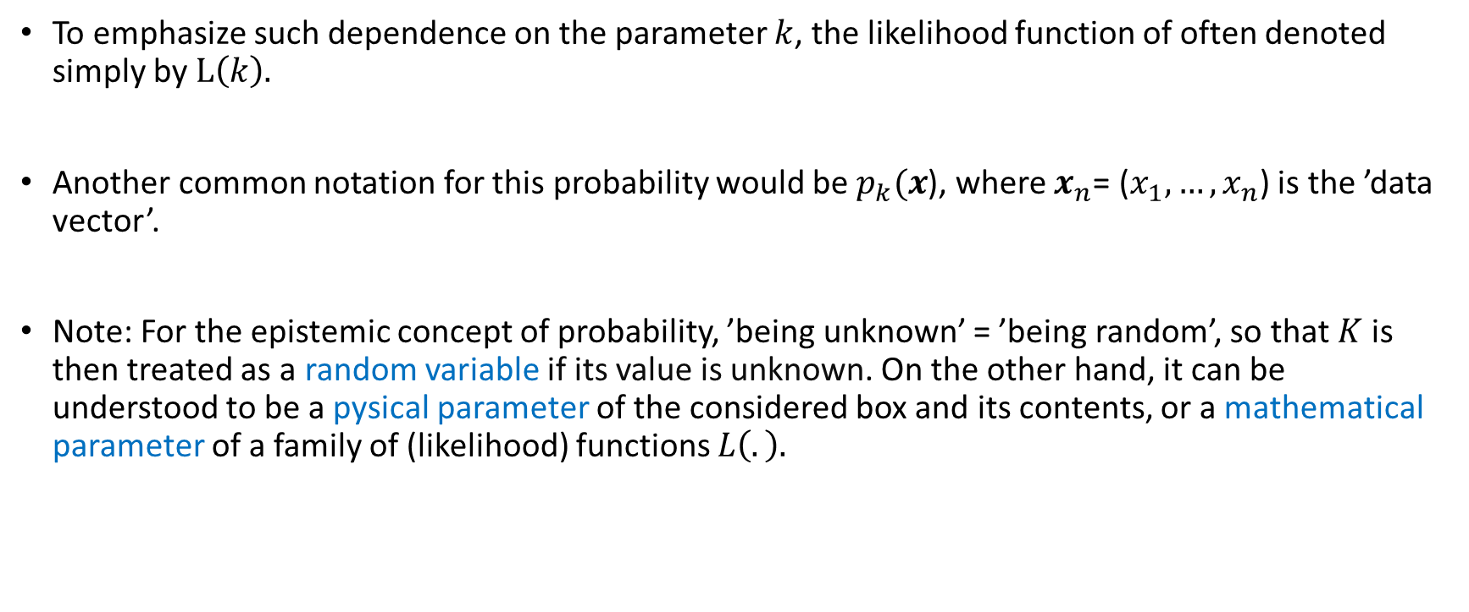
Balls in boxes: more general expressions
To emphasize such dependence on the parameter $k$, the likelihood function of often denoted simply by $L\left(k\right).$
Another common notation for this probability would be $p_{k}(x$), where $x_{n}$= ($x_{1}, …,x_{n}$) is the ’data vector’.
Note: For the epistemic concept of probability, ’being unknown’ = ’being random’, so that $K$is then treated as a random variable if its value is unknown. On the other hand, it can be understood to be a pysical parameter of the considered box and its contents, or a mathematical parameter of a family of (likelihood) functions $L\left(.\right).$

Slide 18
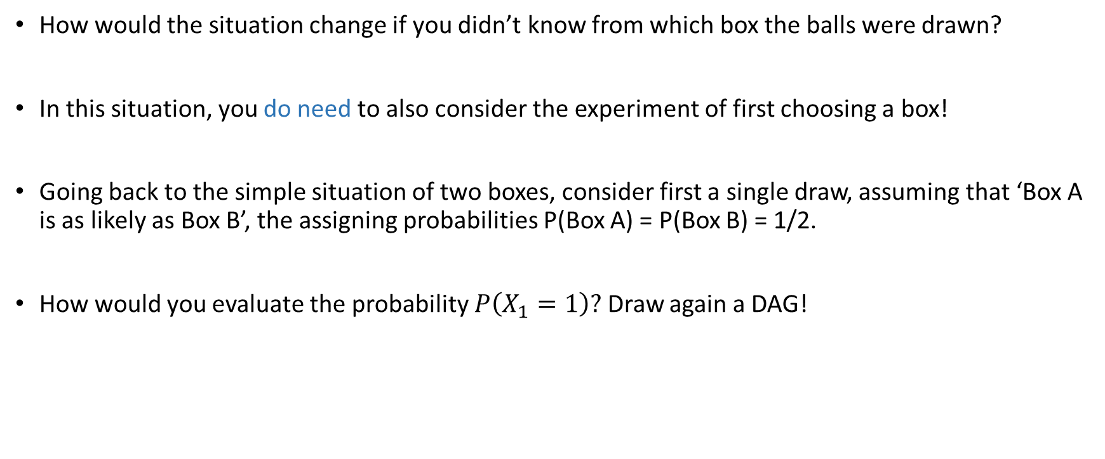
Balls in boxes: unknown number of white balls
How would the situation change if you didn’t know from which box the balls were drawn?
In this situation, you do need to also consider the experiment of first choosing a box!
Going back to the simple situation of two boxes, consider first a single draw, assuming that ‘Box A is as likely as Box B’, the assigning probabilities P(Box A) = P(Box B) = 1/2.
How would you evaluate the probability $P\left(X_{1}=1\right)?$ Draw again a DAG!

Slide 19
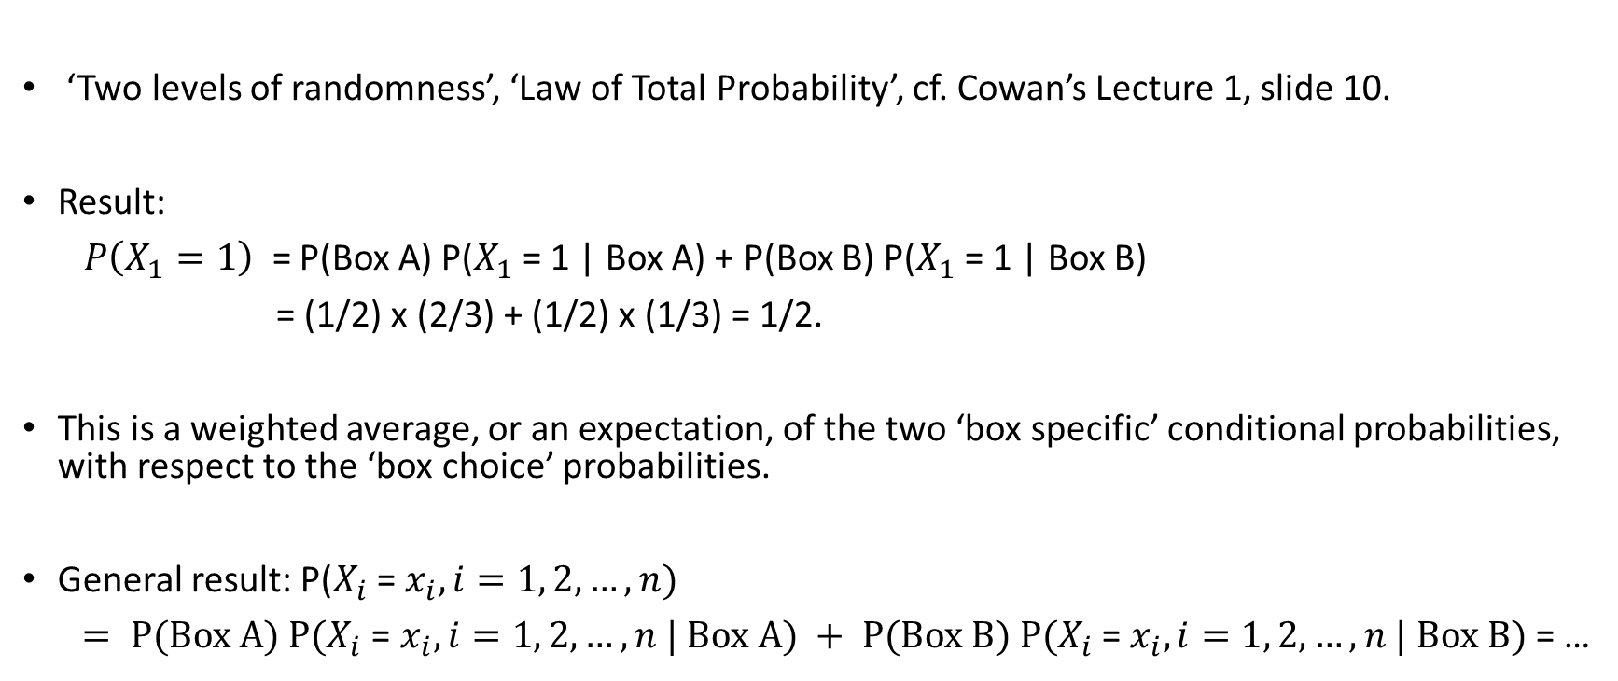
Balls in boxes: unknown number of white balls
‘Two levels of randomness’, ‘Law of Total Probability’, cf. Cowan’s Lecture 1, slide 10.
Result:
$P\left(X_{1}=1\right)$ = P(Box A) P($X_{1}$ = 1 | Box A) + P(Box B) P($X_{1}$ = 1 | Box B)
= (1/2) x (2/3) + (1/2) x (1/3) = 1/2.
This is a weighted average, or an expectation, of the two ‘box specific’ conditional probabilities, with respect to the ‘box choice’ probabilities.
General result: P($X_{i}$ = $x_{i}, i=1, 2,…, n)$
$= P(Box A) P(X_{i}$ = $x_{i}, i=1, 2,…, n | Box A) + P(Box B) P(X_{i}$ = $x_{i}, i=1, 2,…, n | Box B)$= …

Slide 20
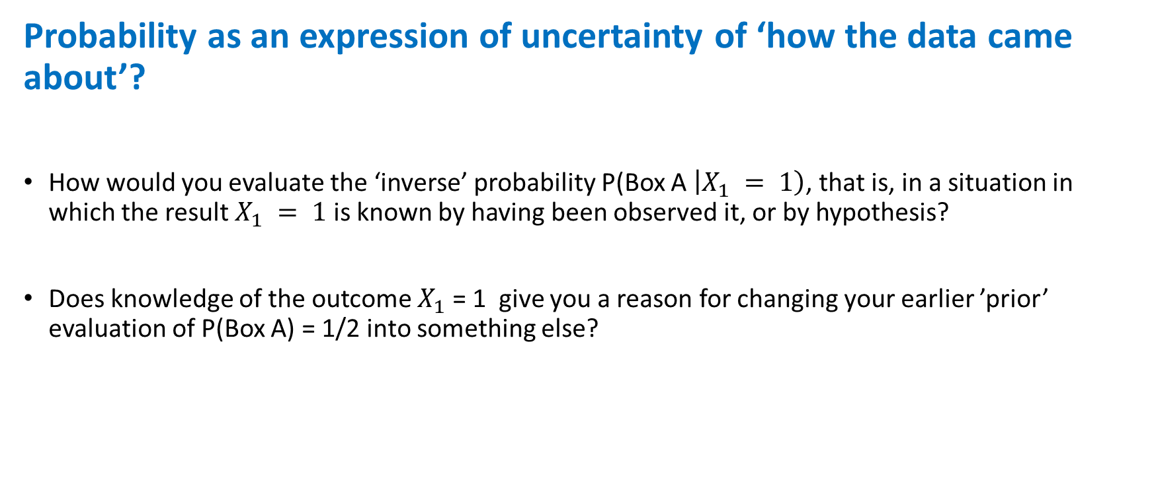
Balls in boxes: ’inverse probability’
Probability as an expression of uncertainty of ‘how the data came about’?
How would you evaluate the ‘inverse’ probability P(Box A $\left|X_{1} = 1\right)$, that is, in a situation in which the result$X_{1} = 1$ is known by having been observed it, or by hypothesis?
Does knowledge of the outcome $X_{1}$ = 1 give you a reason for changing your earlier ’prior’ evaluation of P(Box A) = 1/2 into something else?

Slide 21
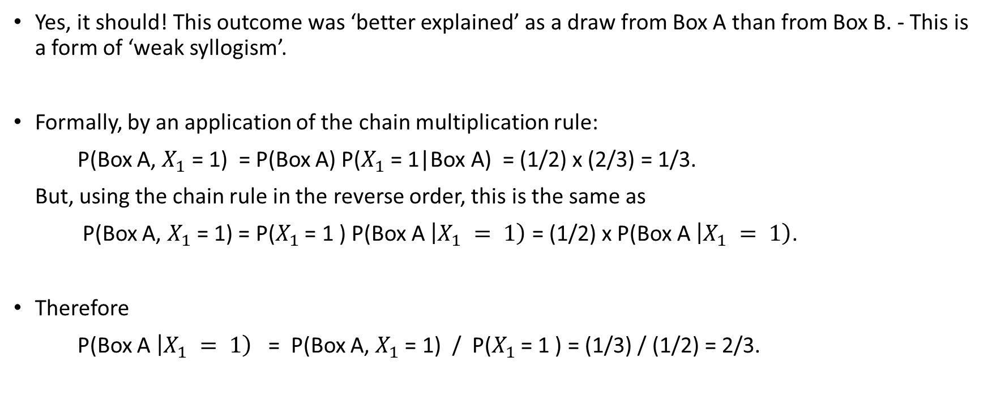
Balls in boxes: ’inverse probability’ and Bayes’ formula
Yes, it should! This outcome was ‘better explained’ as a draw from Box A than from Box B. - This is a form of ‘weak syllogism’.
Formally, by an application of the chain multiplication rule:
P(Box A, $X_{1}$ = 1) = P(Box A) P($X_{1}$ = 1|Box A) = (1/2) x (2/3) = 1/3.
But, using the chain rule in the reverse order, this is the same as
P(Box A, $X_{1}$ = 1) = P($X_{1}$ = 1 ) P(Box A $\left|X_{1} = 1\right)$ = (1/2) x P(Box A $\left|X_{1} = 1\right)$.
Therefore
P(Box A $\left|X_{1} = 1\right)$ = P(Box A, $X_{1}$ = 1) / P($X_{1}$ = 1 ) = (1/3) / (1/2) = 2/3.

Slide 22
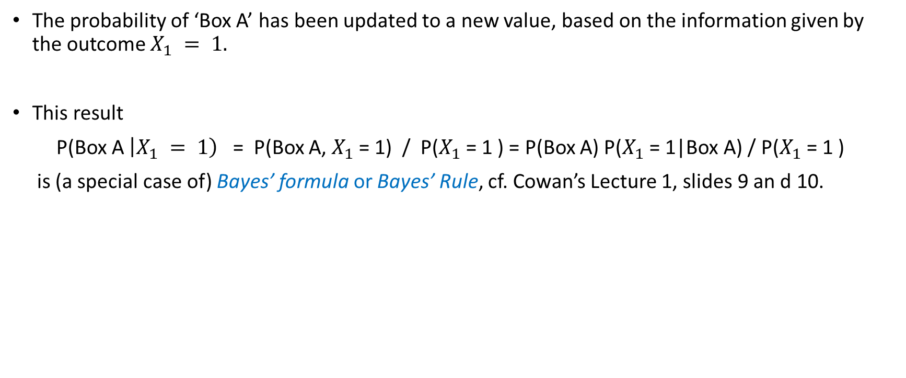
Balls in boxes: ’inverse probability’ and Bayes’ formula
The probability of ‘Box A’ has been updated to a new value, based on the information given by the outcome $X_{1} = 1.$
This result
P(Box A $\left|X_{1} = 1\right)$ = P(Box A, $X_{1}$ = 1) / P($X_{1}$ = 1 ) = P(Box A) P($X_{1}$ = 1|Box A) / P($X_{1}$ = 1 )
is (a special case of) Bayes’ formula or Bayes’ Rule, cf. Cowan’s Lecture 1, slides 9 an d 10.

Slide 23
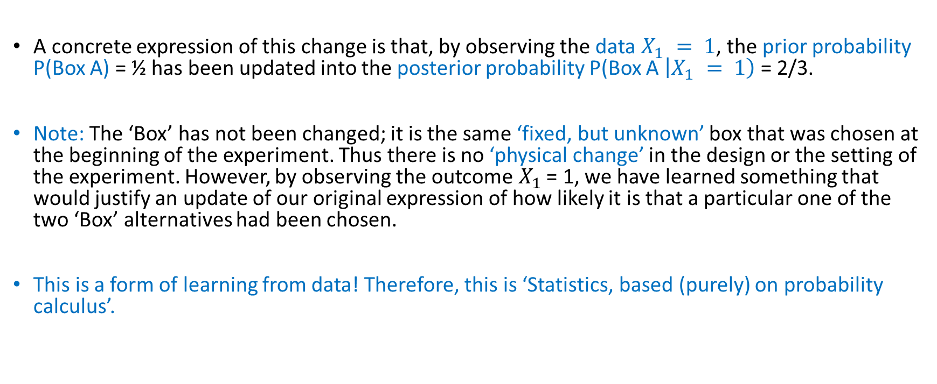
Balls in boxes: ’inverse probability’ and Bayes’ formula
A concrete expression of this change is that, by observing the data $X_{1} = 1$, the prior probability P(Box A) = ½ has been updated into the posterior probability P(Box A $\left|X_{1} = 1\right)$ = 2/3.
Note: The ‘Box’ has not been changed; it is the same ‘fixed, but unknown’ box that was chosen at the beginning of the experiment. Thus there is no ‘physical change’ in the design or the setting of the experiment. However, by observing the outcome${ X}_{1}$ = 1, we have learned something that would justify an update of our original expression of how likely it is that a particular one of the two ‘Box’ alternatives had been chosen.
This is a form of learning from data! Therefore, this is ‘Statistics, based (purely) on probability calculus’.

Slide 24

Balls in boxes: inductive learning from data
Next question: In this situation, how would you evaluate the conditional ‘predictive’ probability
P($X_{2}$ = $1 \left|X_{1} = 1\right)?$

Slide 25
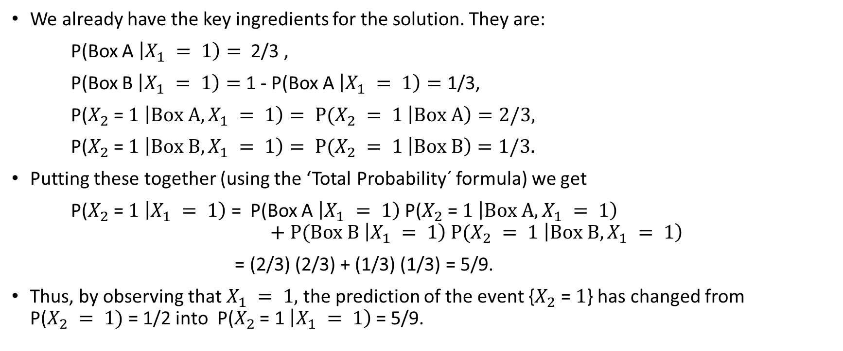
Balls in boxes: inductive learning from data
We already have the key ingredients for the solution. They are:
P(Box A $\left|X_{1} = 1\right)=$ 2/3 ,
P(Box B $\left|X_{1} = 1\right)=$ 1 - P(Box A $\left|X_{1} = 1\right)=$ 1/3,
P($X_{2}$ = $1 \left|Box A, X_{1} = 1\right)= P(X_{2} = 1 \left|Box A\right)=2/3,$
P($X_{2}$ = $1 \left|Box B, X_{1} = 1\right)= P(X_{2} = 1 \left|Box B\right)=1/3.$
Putting these together (using the ‘Total Probability´ formula) we get
P($X_{2}$ = $1 \left|X_{1} = 1\right)$ = P(Box A $\left|X_{1} = 1\right)$ P($X_{2}$ = $1 \left|Box A, X_{1} = 1\right)$
$$+ P(Box B \left|X_{1} = 1\right) P(X_{2} = 1 \left|Box B, X_{1} = 1\right)$$
= (2/3) (2/3) + (1/3) (1/3) = 5/9.
Thus, by observing that $X_{1} = 1,$ the prediction of the event {$X_{2}$ = $1$} has changed from P($X_{2} = 1)$= 1/2 into P($X_{2}$ = 1$\left|X_{1} = 1\right)$ = 5/9.

Slide 26
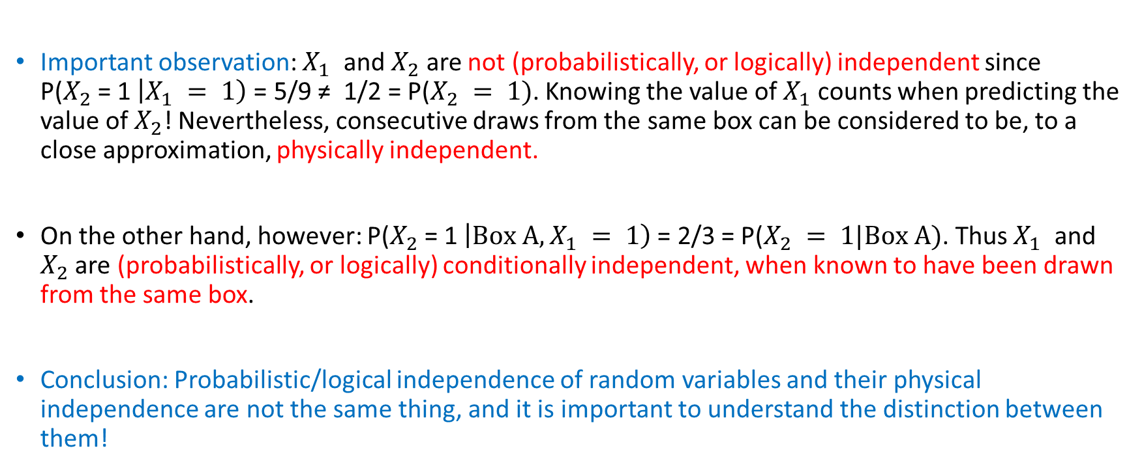
Balls in boxes: remarks on independence
Important observation: $X_{1}$ and $X_{2}$ are not (probabilistically, or logically) independent since P($X_{2}$ = 1$\left|X_{1} = 1\right)$ = 5/9 ≠ 1/2 = P($X_{2} = 1)$. Knowing the value of $X_{1}$ counts when predicting the value of${ X}_{2}$! Nevertheless, consecutive draws from the same box can be considered to be, to a close approximation, physically independent.
On the other hand, however: P($X_{2}$ = 1$\left|Box A,X_{1} = 1\right)$ = 2/3 = P($X_{2} = 1|Box A)$. Thus $X_{1}$ and $X_{2}$ are (probabilistically, or logically) conditionally independent, when known to have been drawn from the same box.
Conclusion: Probabilistic/logical independence of random variables and their physical independence are not the same thing, and it is important to understand the distinction between them!

Slide 27
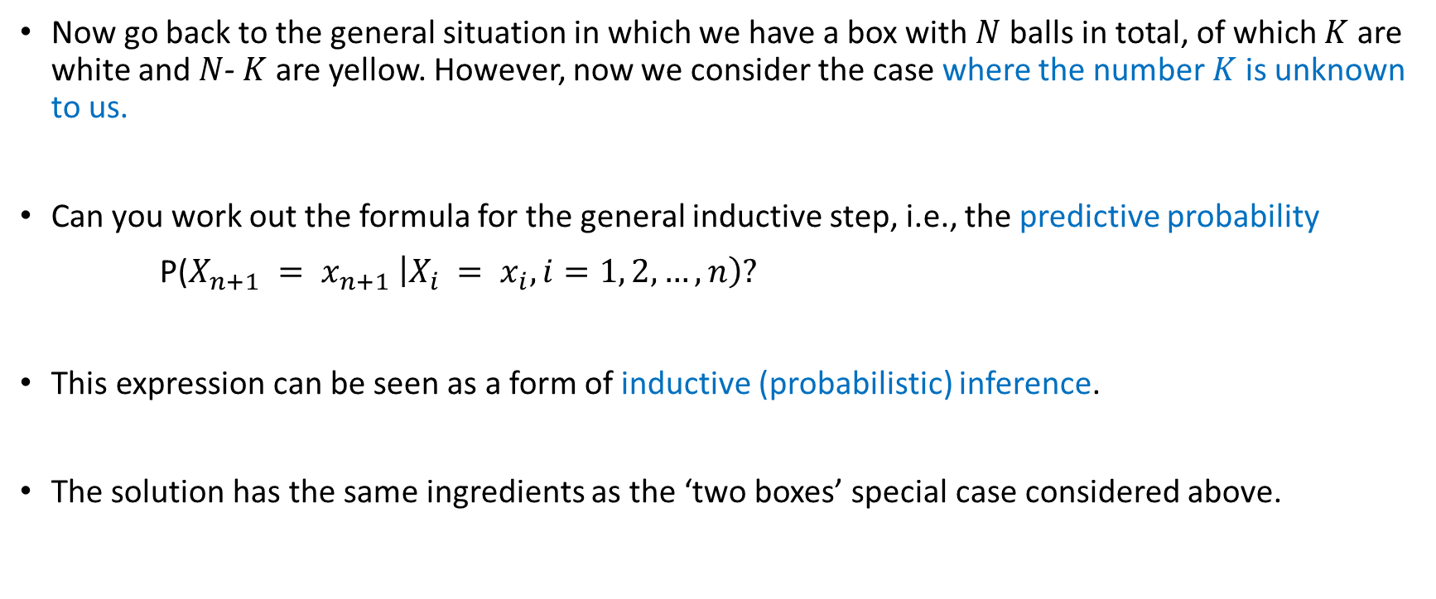
Balls in boxes: inductive learning from data
Now go back to the general situation in which we have a box with $N$balls in total, of which $K$ are white and $N$- $K$ are yellow. However, now we consider the case where the number $K$ is unknown to us.
Can you work out the formula for the general inductive step, i.e., the predictive probability
P(${X_{n+1} = x_{n+1}}_{ }\left|X_{i} = x_{i}, i=1, 2, …, n\right)?$
This expression can be seen as a form of inductive (probabilistic) inference.
The solution has the same ingredients as the ‘two boxes’ special case considered above.

Slide 28
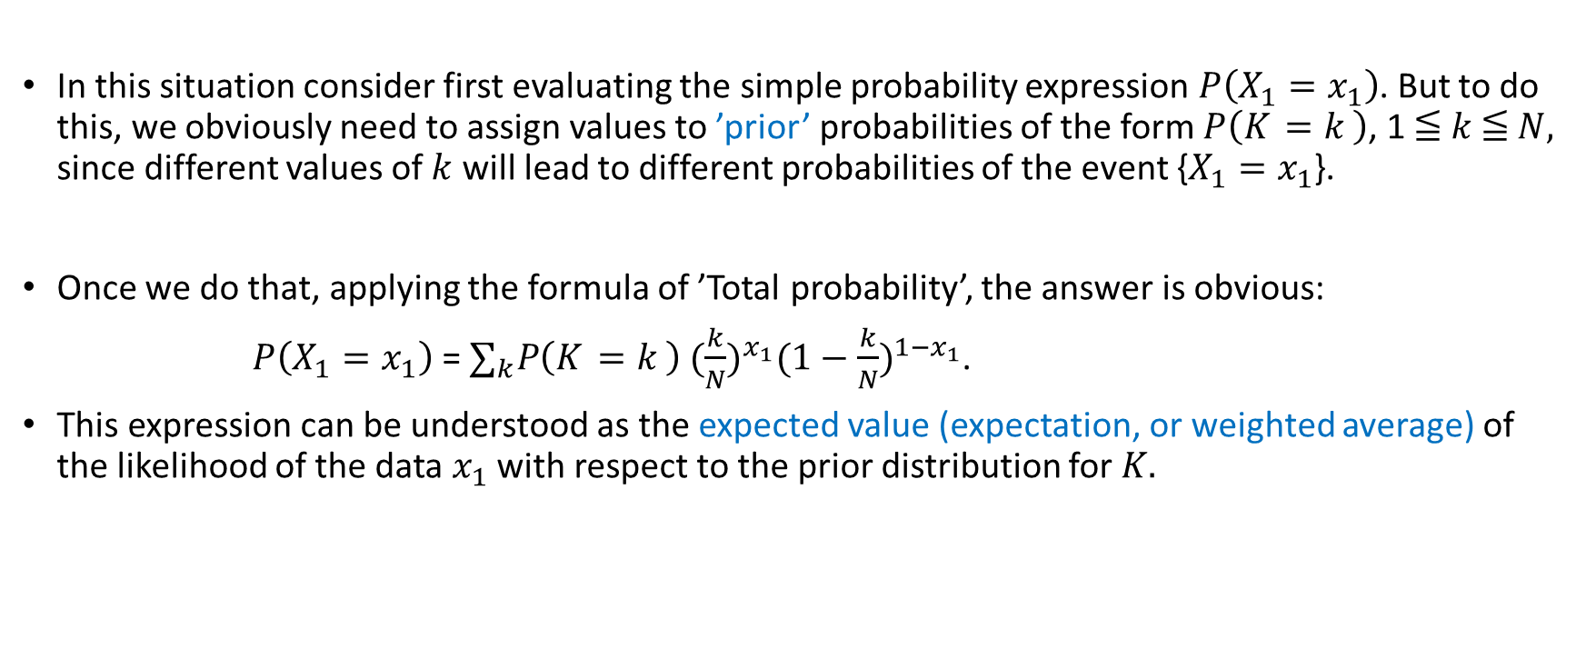
Balls in boxes: inductive learning from data
In this situation consider first evaluating the simple probability expression $P\left(X_{1}=x_{1}\right)$. But to do this, we obviously need to assign values to ’prior’ probabilities of the form $P\left(K_{ }=k_{ }\right)$, 1 ≦ $k$≦ $N,$ since different values of $k$ will lead to different probabilities of the event {$X_{1}=x_{1}$}.
Once we do that, applying the formula of ’Total probability’, the answer is obvious:
$P\left(X_{1}=x_{1}\right)$ = $∑_{k}P\left(K_{ }=k_{ }\right)$ ${(\frac{k}{N})}^{x_{1}}{(1−\frac{k}{N})}^{{1−x}_{1}}$.
This expression can be understood as the expected value (expectation, or weighted average) of the likelihood of the data $x_{1}$ with respect to the prior distribution for $K.$

Slide 29
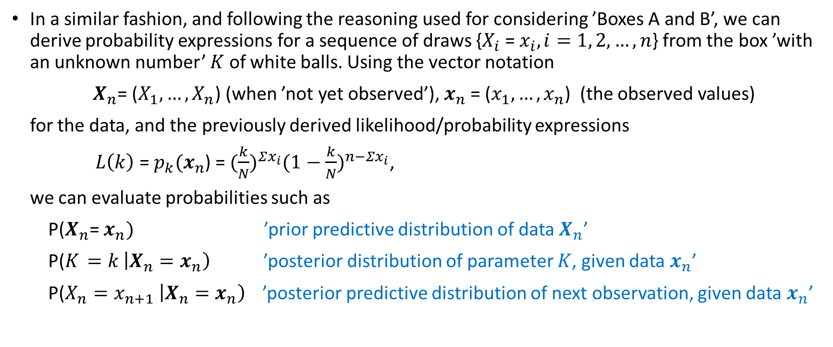
Balls in boxes: inductive learning from data
In a similar fashion, and following the reasoning used for considering ’Boxes A and B’, we can derive probability expressions for a sequence of draws {$X_{i}$ = $x_{i}, i=1, 2,…, n$} from the box ’with an unknown number’ $K$ of white balls. Using the vector notation
$X_{n}$= ($X_{1}, …,X_{n}$) (when ’not yet observed’), $x_{n}$= ($x_{1}, …,x_{n}$) (the observed values)
for the data, and the previously derived likelihood/probability expressions
$L\left(k\right)$ = $p_{k}(x_{n}$) = ${(\frac{k}{N})}^{Σx_{i}}{(1−\frac{k}{N})}^{n−Σx_{i}}$,
we can evaluate probabilities such as
P($X_{n}$= $x_{n})$ ’prior predictive distribution of data $X_{n}$’
P($K_{ }=k_{ }\left|X_{n}=x_{n}\right)$ ’posterior distribution of parameter $K$, given data $x_{n}$’
P(${X_{n}=x_{n+1}}_{ }\left|X_{n}=x_{n}\right)$ ’posterior predictive distribution of next observation, given data $x_{n}$’

Slide 30
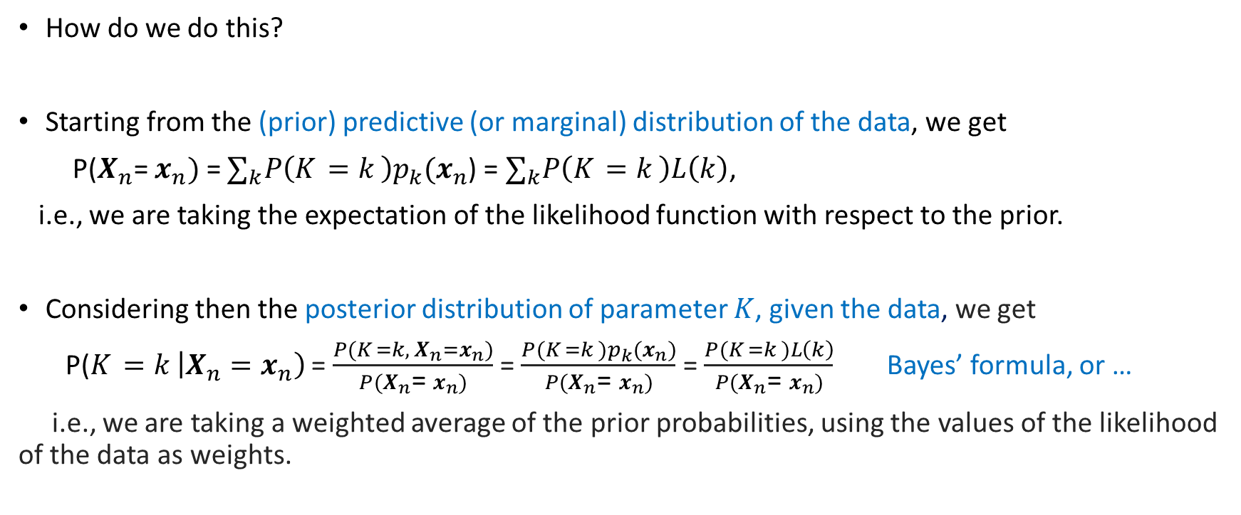
Balls in boxes: inductive learning from data
How do we do this?
Starting from the (prior) predictive (or marginal) distribution of the data, we get
P($X_{n}$= $x_{n})$ = $∑_{k}P\left(K_{ }=k_{ }\right)p_{k}(x_{n}$) = $∑_{k}P\left(K_{ }=k_{ }\right)L\left(k\right)$,
i.e., we are taking the expectation of the likelihood function with respect to the prior.
Considering then the posterior distribution of parameter $K$, given the data, we get
P($K_{ }=k_{ }\left|X_{n}=x_{n}\right)$ = $\frac{{P(K}_{ }={k,}_{ }X_{n}=x_{n})}{{P(X}_{n}\text{= }x_{n})}$ = $\frac{{P(K}_{ }=k_{ })p_{k}(x_{n})}{{P(X}_{n}\text{= }x_{n})}$ = $\frac{{P(K}_{ }=k_{ })L\left(k\right)}{{P(X}_{n}\text{= }x_{n})}$ Bayes’ formula, or …
i.e., we are taking a weighted average of the prior probabilities, using the values of the likelihood of the data as weights.

Slide 31
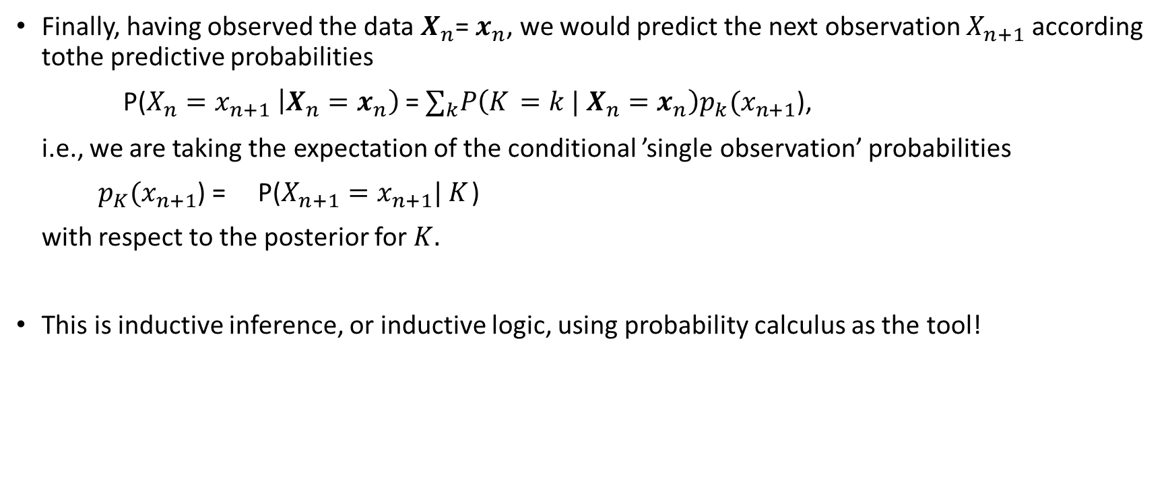
Balls in boxes: inductive learning from data
Finally, having observed the data $X_{n}$= $x_{n}$, we would predict the next observation $X_{n+1}$ according tothe predictive probabilities
P(${X_{n}=x_{n+1}}_{ }\left|X_{n}=x_{n}\right)$ = $∑_{k}P\left(K_{ }={k |}_{ }X_{n}=x_{n}\right)p_{k}(x_{n+1}$),
i.e., we are taking the expectation of the conditional ’single observation’ probabilities
$p_{K}(x_{n+1}$) = P($X_{n+1}=x_{n+1}{| K}_{ }$)
with respect to the posterior for ${K.}_{ }$
This is inductive inference, or inductive logic, using probability calculus as the tool!

Slide 32
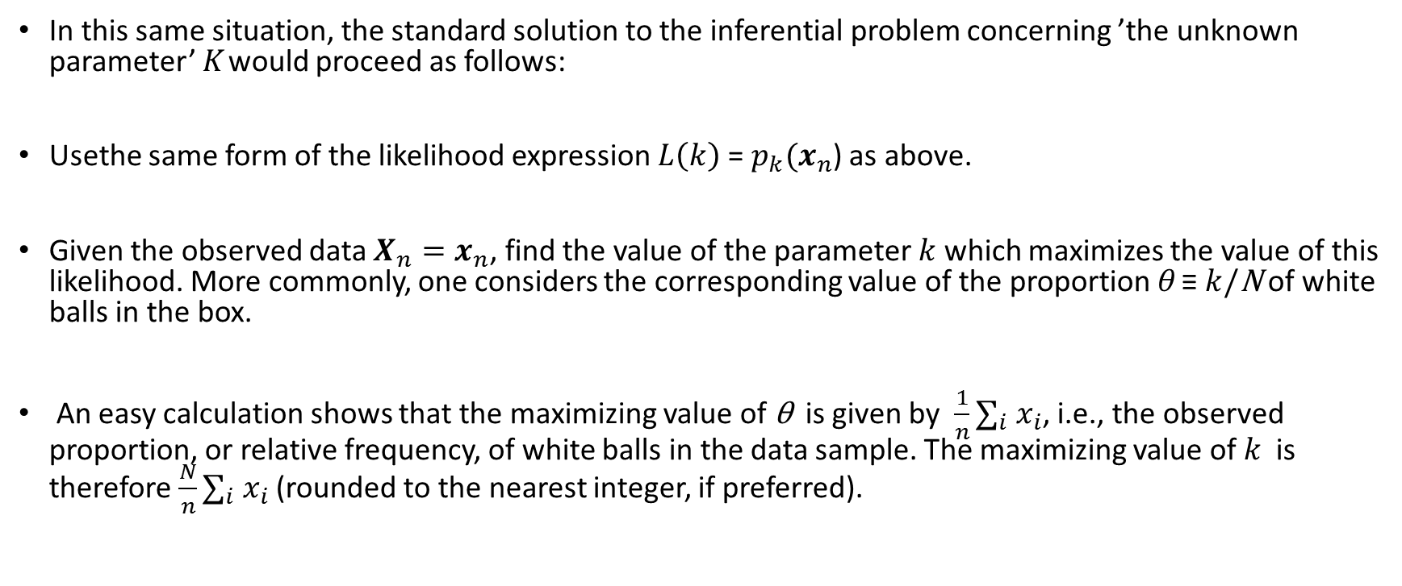
Quick comparison to classical/frequentist inference
In this same situation, the standard solution to the inferential problem concerning ’the unknown parameter’ $K_{ }$would proceed as follows:
Usethe same form of the likelihood expression $L\left(k\right)$ = $p_{k}(x_{n}$) as above.
Given the observed data $X_{n}=x_{n}$, find the value of the parameter $k$ which maximizes the value of this likelihood. More commonly, one considers the corresponding value of the proportion θ ≡ $k$/N of white balls in the box.
An easy calculation shows that the maximizing value of θ is given by $\frac{1}{n}∑_{i} x_{i}$, i.e., the observed proportion, or relative frequency, of white balls in the data sample. The maximizing value of $k$ is therefore $\frac{N}{n}∑_{i} x_{i}$ (rounded to the nearest integer, if preferred).

Slide 33
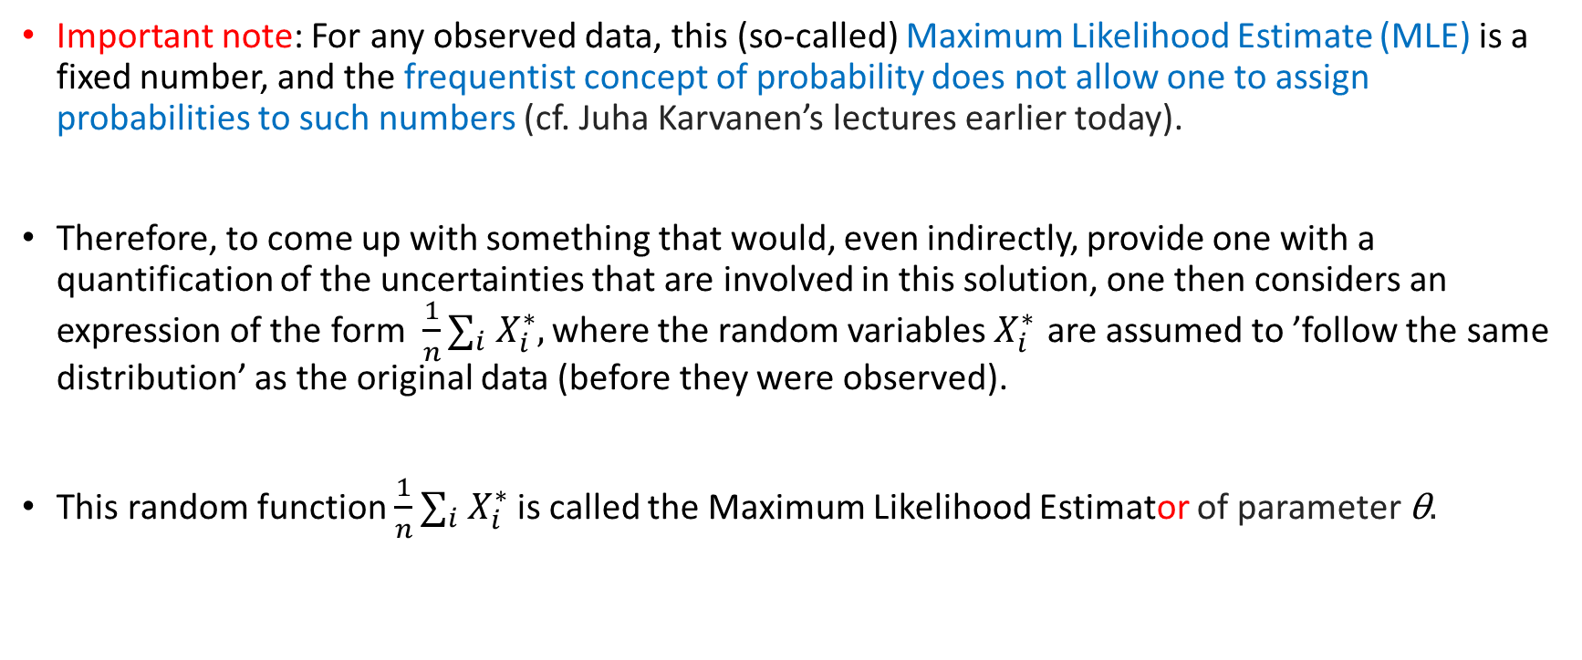
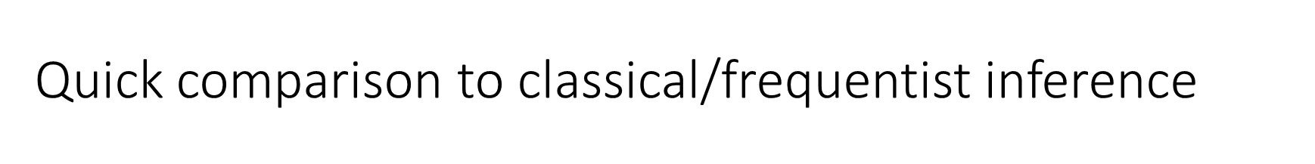
Quick comparison to classical/frequentist inference
Important note: For any observed data, this (so-called) Maximum Likelihood Estimate (MLE) is a fixed number, and the frequentist concept of probability does not allow one to assign probabilities to such numbers (cf. Juha Karvanen’s lectures earlier today).
Therefore, to come up with something that would, even indirectly, provide one with a quantification of the uncertainties that are involved in this solution, one then considers an expression of the form $\frac{1}{n}∑_{i} X_{i}^{∗},_{ }$where the random variables $X_{i}^{∗}$ are assumed to ’follow the same distribution’ as the original data (before they were observed).
This random function $\frac{1}{n}∑_{i} X_{i}^{∗}$ is called the Maximum Likelihood Estimator of parameter θ$.$

Slide 34
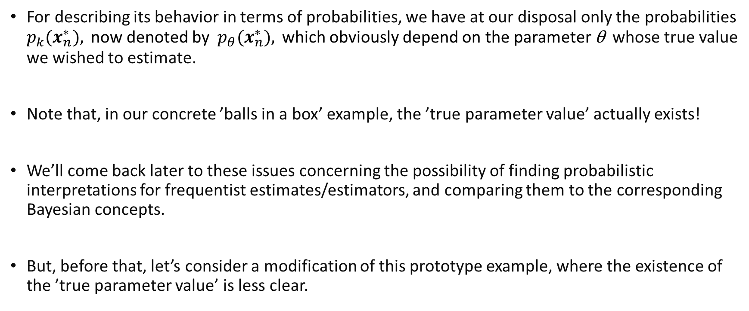
Quick comparison to classical/frequentist inference
For describing its behavior in terms of probabilities, we have at our disposal only the probabilities $p_{k}({x_{n}^{∗}), }_{ }$ now denoted by ${p_{θ}({x_{n}^{∗}), }_{ }}_{ }$which obviously depend on the parameter θ whose true value we wished to estimate.
Note that, in our concrete ’balls in a box’ example, the ’true parameter value’ actually exists!
We’ll come back later to these issues concerning the possibility of finding probabilistic interpretations for frequentist estimates/estimators, and comparing them to the corresponding Bayesian concepts.
But, before that, let’s consider a modification of this prototype example, where the existence of the ’true parameter value’ is less clear.

Slide 35
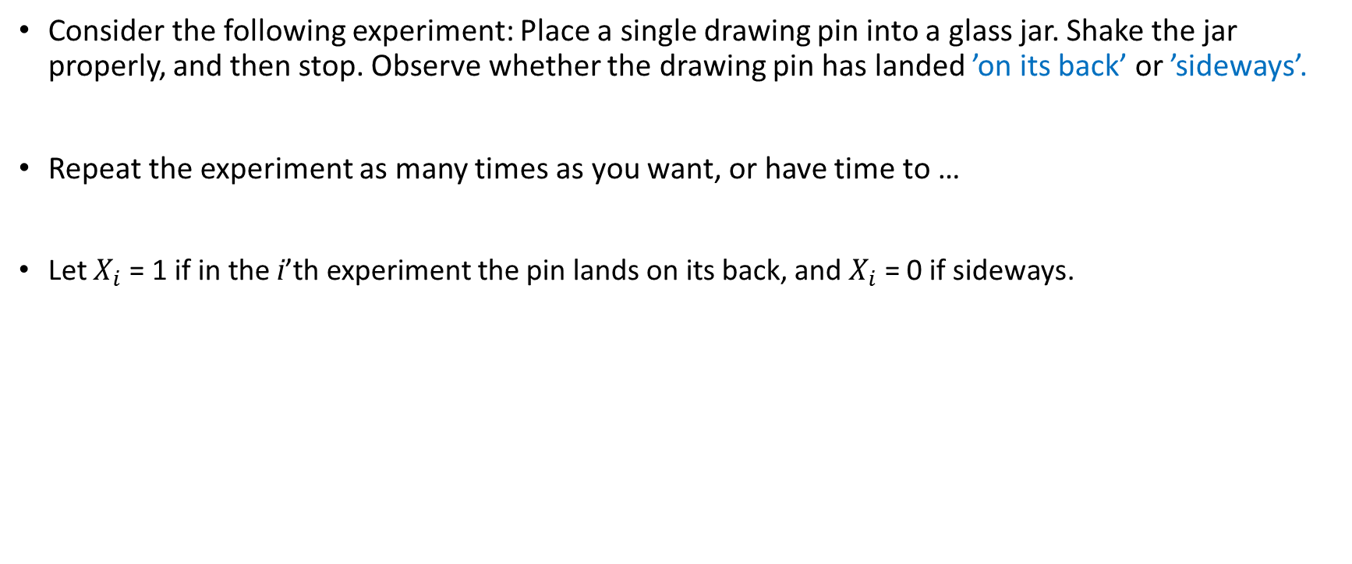
A drawing pin in a glass jar
Consider the following experiment: Place a single drawing pin into a glass jar. Shake the jar properly, and then stop. Observe whether the drawing pin has landed ’on its back’ or ’sideways’.
Repeat the experiment as many times as you want, or have time to …
Let $X_{i}$ = 1 if in the i’th experiment the pin lands on its back, and $X_{i}$ = 0 if sideways.

Slide 36
A drawing pin in a glass jar
How does this compare with the ’balls in the box’ experiment we considered earlier?
There we concluded that, for setting up a probability model for the experiment, its essential reatures were that
There were N balls in the box, of which K were white;
The balls were ’similar’, apart from color;
To a sufficient approximation, the results from different repetitions of the experiment could be considered ’physically independent’.
In the ’drawing pin in a glass jar’ experiment, it is impossible to find direct correspondnece to (i) and (ii) above, while (iii) appears still relevant.

Slide 37

A drawing pin in a glass jar: existence of parameter?
With N and K missing, how could we find a ’parameter’ describing this experiment that would somehow correspond to θ ≡ $k$/N that was considered earlier?
The symmetry argument leading to the ’classical definition’ of probability, with specified numerical values in each context, clearly does not apply here.

Slide 38
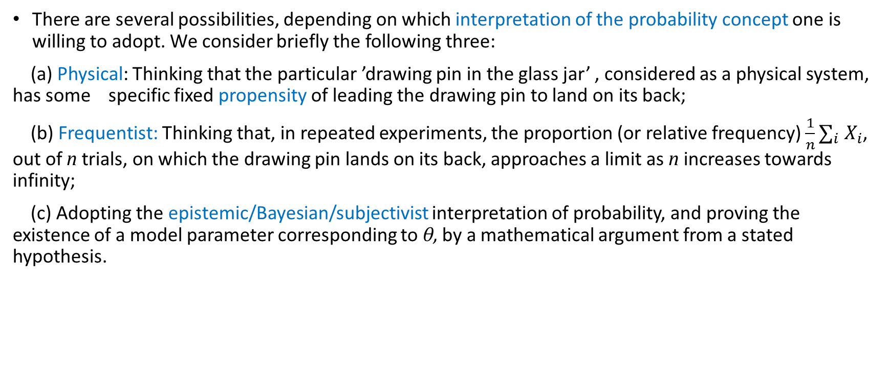
A drawing pin in a glass jar: existence of parameter?
There are several possibilities, depending on which interpretation of the probability concept one is willing to adopt. We consider briefly the following three:
(a) Physical: Thinking that the particular ’drawing pin in the glass jar’ , considered as a physical system, has some specific fixed propensity of leading the drawing pin to land on its back;
(b) Frequentist: Thinking that, in repeated experiments, the proportion (or relative frequency) $\frac{1}{n}∑_{i} X_{i}$, out of n trials, on which the drawing pin lands on its back, approaches a limit as n increases towards infinity;
(c) Adopting the epistemic/Bayesian/subjectivist interpretation of probability, and proving the existence of a model parameter corresponding to θ, by a mathematical argument from a stated hypothesis.

Slide 39
A drawing pin in a glass jar: existence of parameter?
Notes: The frequentist approach (b) is often described in terms of ’independent sampling from an infinite population’. Of course, no infinite populations exist in reality, but this idea may serve as an approximation if the underlying population is large.
On the other hand, literally speaking, the model is then really a description of the sampling mechanism, rather than of the characteristics of the individual members of the population.

Slide 40

A drawing pin in a glass jar: existence of parameter?
Alternatives (a) and (b) are clearly pleasant from the perspective that, if adopted, they will directly postulate the existence of a parameter θ, with values 0 ≦ θ ≦ 1, and meaning
θ ≡ P($X_{i}$ = $x_{i}), i=1, 2,…$
Combining this with with the ’pysical independence of different trials property’ (iii) above, lets us then specify a probability model of the obvious form
$P_{θ}$($X_{n}$= $x_{n})$ =$p_{θ}(x_{n}$) = $θ^{Σx_{i}}{(1−θ)}^{n−Σx_{i}}$.

Slide 41
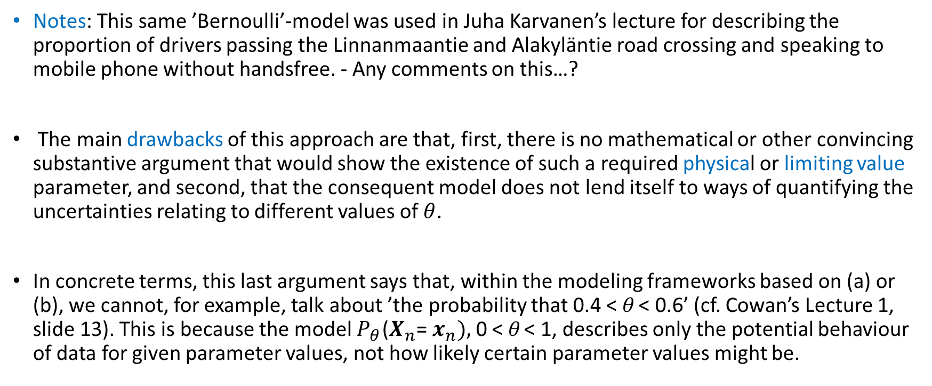
A drawing pin in a glass jar: existence of parameter?
Notes: This same ’Bernoulli’-model was used in Juha Karvanen’s lecture for describing the proportion of drivers passing the Linnanmaantie and Alakyläntie road crossing and speaking to mobile phone without handsfree. - Any comments on this…?
The main drawbacks of this approach are that, first, there is no mathematical or other convincing substantive argument that would show the existence of such a required physical or limiting value parameter, and second, that the consequent model does not lend itself to ways of quantifying the uncertainties relating to different values of $θ$.
In concrete terms, this last argument says that, within the modeling frameworks based on (a) or (b), we cannot, for example, talk about ’the probability that 0.4 < θ < 0.6’ (cf. Cowan’s Lecture 1, slide 13). This is because the model $P_{θ}$($X_{n}$= $x_{n}),$ 0 < θ < 1, describes only the potential behaviour of data for given parameter values, not how likely certain parameter values might be.

Slide 42
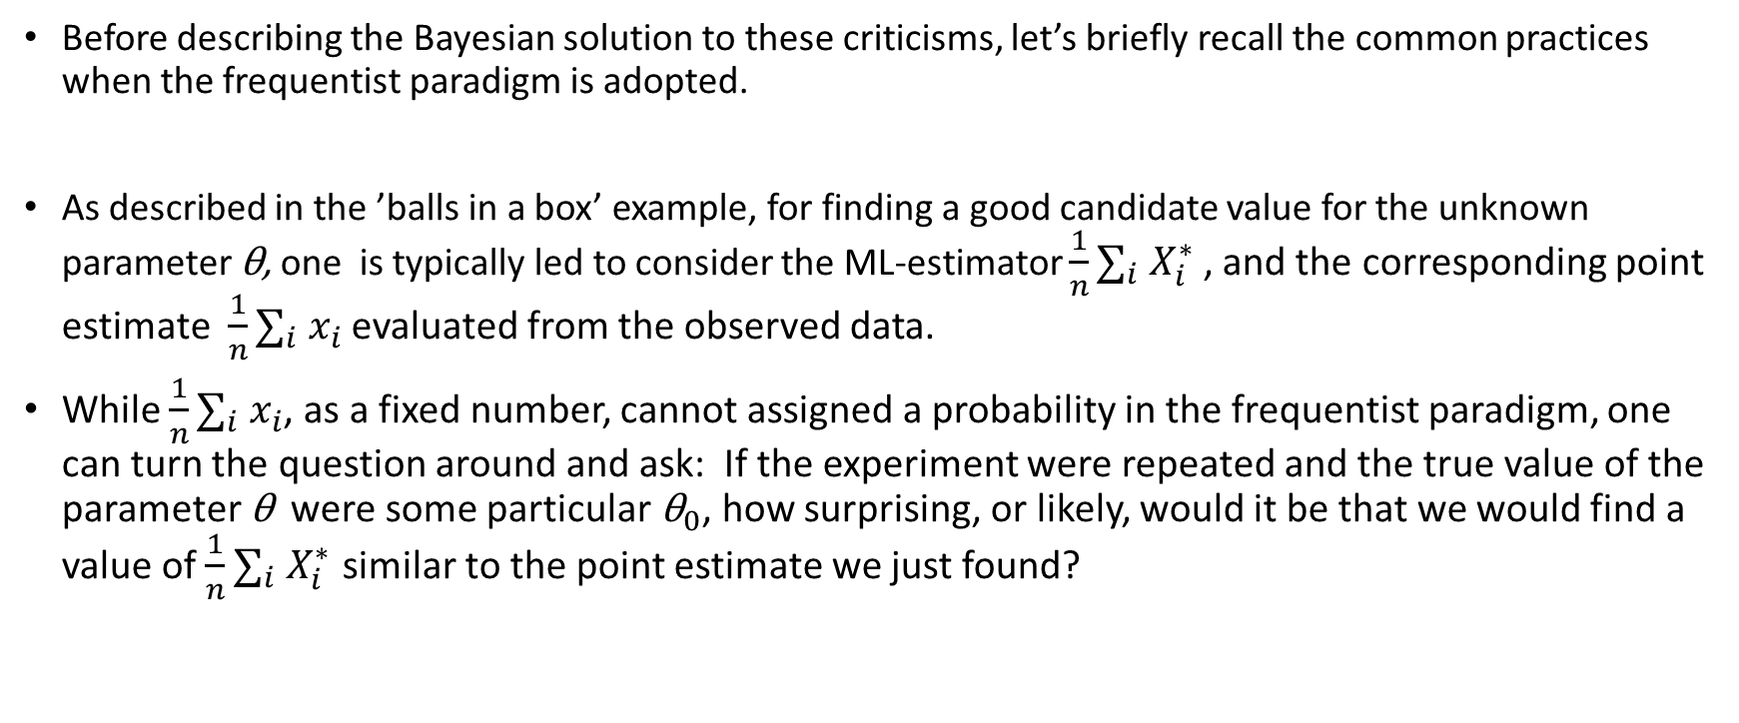
A drawing pin in a glass jar: frequentist considerations
Before describing the Bayesian solution to these criticisms, let’s briefly recall the common practices when the frequentist paradigm is adopted.
As described in the ’balls in a box’ example, for finding a good candidate value for the unknown parameter θ, one is typically led to consider the ML-estimator $\frac{1}{n}∑_{i} X_{i}^{∗}$ , and the corresponding point estimate $\frac{1}{n}∑_{i} x_{i}$ evaluated from the observed data.
While $\frac{1}{n}∑_{i} x_{i}$, as a fixed number, cannot assigned a probability in the frequentist paradigm, one can turn the question around and ask: If the experiment were repeated and the true value of the parameter θ were some particular ${\text{θ}}_{0}$, how surprising, or likely, would it be that we would find a value of $\frac{1}{n}∑_{i} X_{i}^{∗}$ similar to the point estimate we just found?

Slide 43
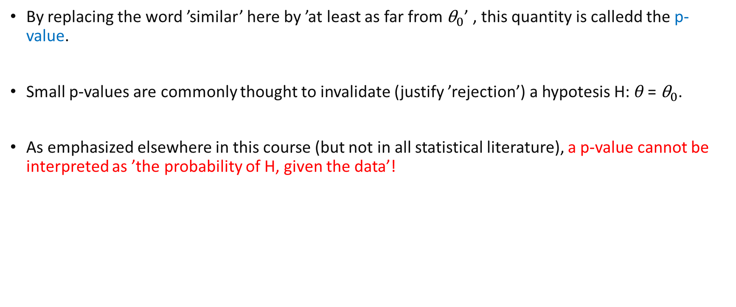
A drawing pin in a glass jar: frequentist considerations
By replacing the word ’similar’ here by ’at least as far from ${\text{θ}}_{0}$’ , this quantity is calledd the p-value.
Small p-values are commonly thought to invalidate (justify ’rejection’) a hypotesis H: θ = ${\text{θ}}_{0}$.
As emphasized elsewhere in this course (but not in all statistical literature), a p-value cannot be interpreted as ’the probability of H, given the data’!

Slide 44
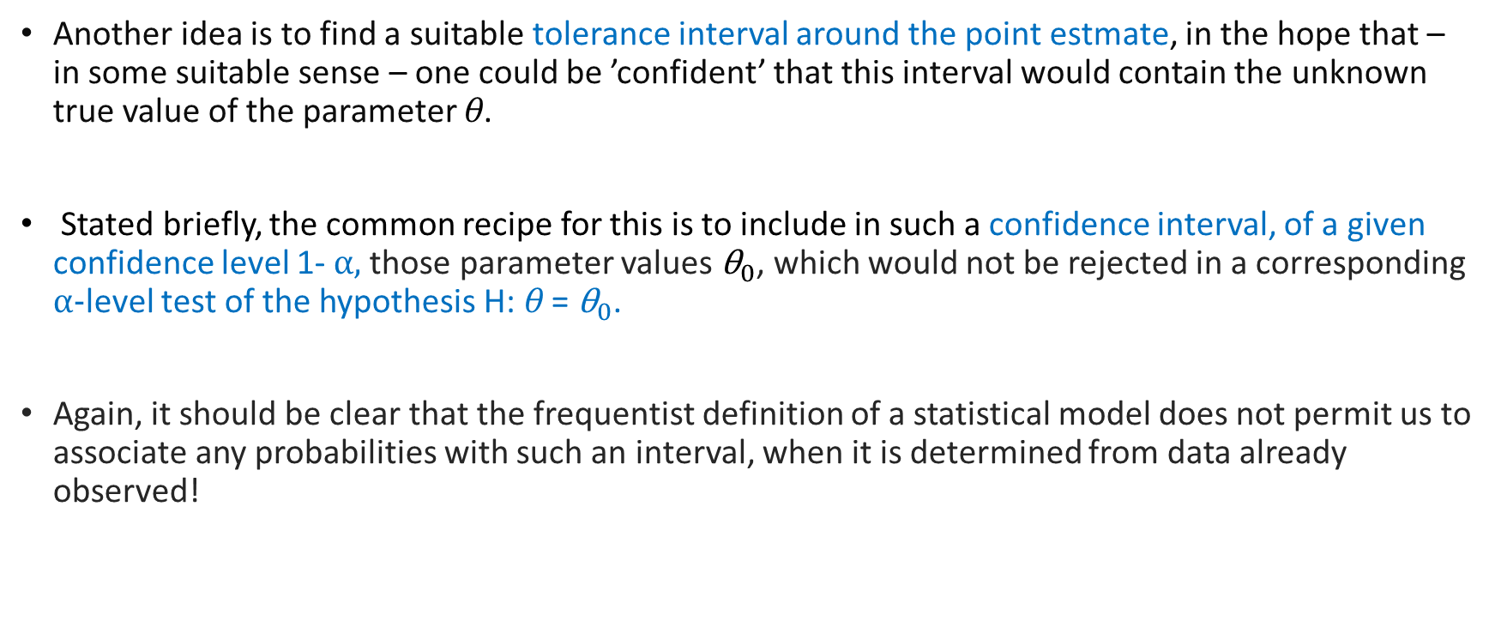
A drawing pin in a glass jar: frequentist considerations
Another idea is to find a suitable tolerance interval around the point estmate, in the hope that – in some suitable sense – one could be ’confident’ that this interval would contain the unknown true value of the parameter θ.
Stated briefly, the common recipe for this is to include in such a confidence interval, of a given confidence level 1- α, those parameter values${ \text{θ}}_{0}$, which would not be rejected in a corresponding α-level test of the hypothesis H: θ = ${\text{θ}}_{0}$.
Again, it should be clear that the frequentist definition of a statistical model does not permit us to associate any probabilities with such an interval, when it is determined from data already observed!

Slide 45
A drawing pin in a glass jar: Bayesian considerations
In the Bayesian approach to statistical mdoeling and inference, probability is a quantitative expression of a person’s (for example, my) uncertainty.
As noted before, in experiments such as the ’drawing pin in a glass jar’, there is no readily available physical parameter that could fo be the basis of forming a a suitable probability model.

Slide 46
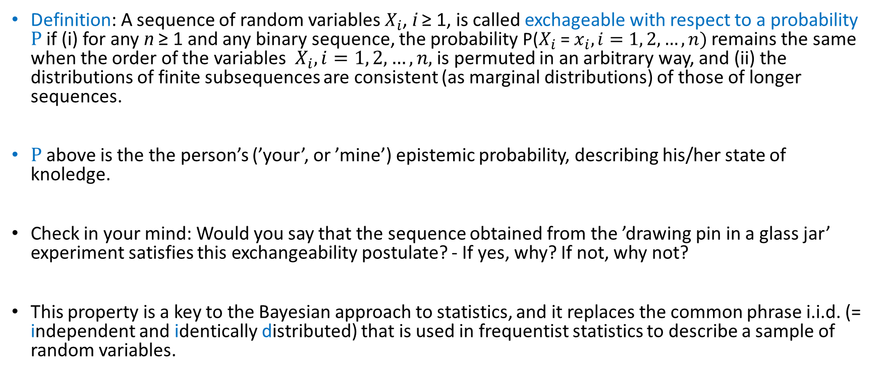
A drawing pin in a glass jar: Bayesian considerations
Definition: A sequence of random variables $X_{i}$, i ≥ 1, is called exchageable with respect to a probability P if (i) for any n ≥ 1 and any binary sequence, the probability P($X_{i}$ = $x_{i}, i=1, 2,…, n)$remains the same when the order of the variables $X_{i}, i=1, 2, …, n,$is permuted in an arbitrary way, and (ii) the distributions of finite subsequences are consistent (as marginal distributions) of those of longer sequences.
P above is the the person’s (’your’, or ’mine’) epistemic probability, describing his/her state of knoledge.
Check in your mind: Would you say that the sequence obtained from the ’drawing pin in a glass jar’ experiment satisfies this exchangeability postulate? - If yes, why? If not, why not?
This property is a key to the Bayesian approach to statistics, and it replaces the common phrase i.i.d. (= independent and identically distributed) that is used in frequentist statistics to describe a sample of random variables.

Slide 47
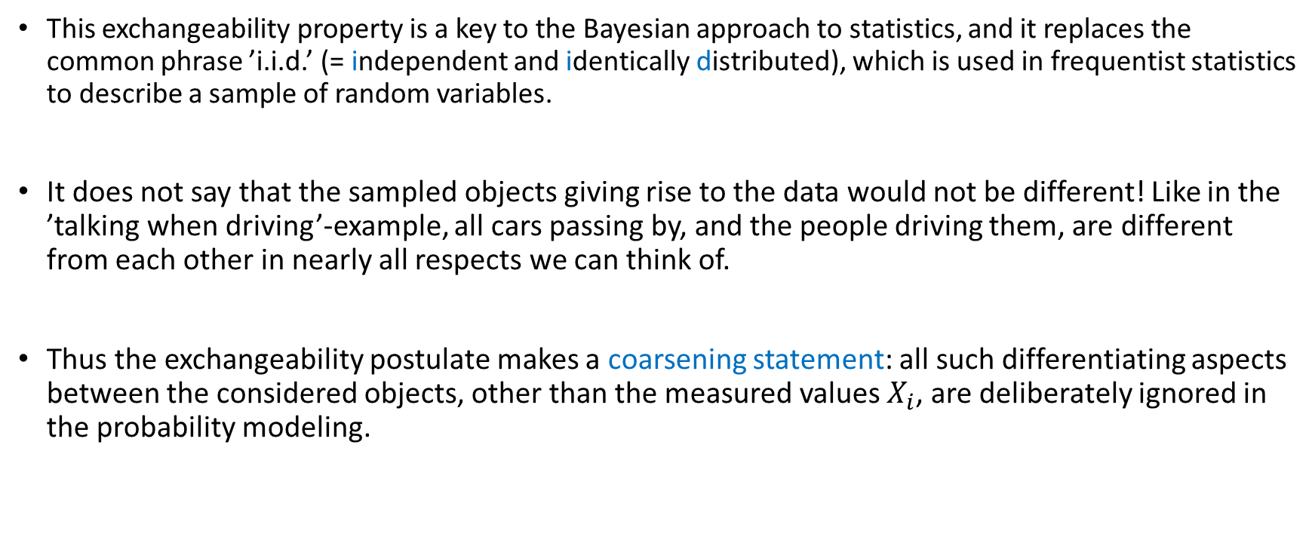
A drawing pin in a glass jar: Bayesian considerations
This exchangeability property is a key to the Bayesian approach to statistics, and it replaces the common phrase ’i.i.d.’ (= independent and identically distributed), which is used in frequentist statistics to describe a sample of random variables.
It does not say that the sampled objects giving rise to the data would not be different! Like in the ’talking when driving’-example, all cars passing by, and the people driving them, are different from each other in nearly all respects we can think of.
Thus the exchangeability postulate makes a coarsening statement: all such differentiating aspects between the considered objects, other than the measured values $X_{i}$, are deliberately ignored in the probability modeling.

Slide 48
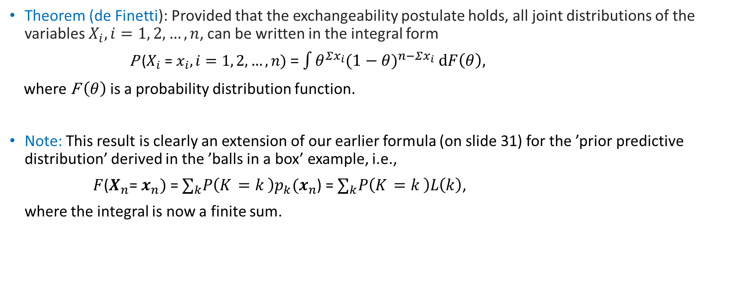
A drawing pin in a glass jar: Bayesian considerations
Theorem (de Finetti): Provided that the exchangeability postulate holds, all joint distributions of the variables $X_{i}, i=1, 2, …, n$, can be written in the integral form
P ($X_{i}$ = $x_{i}, i=1, 2,…, n)$ = $\int{θ^{Σx_{i}}{(1−θ)}^{n−Σx_{i}} dF\left(θ\right),}$
where F $\left(θ\right)$is a probability distribution function.
Note: This result is clearly an extension of our earlier formula (on slide 31) for the ’prior predictive distribution’ derived in the ’balls in a box’ example, i.e.,
$F$($X_{n}$= $x_{n})$ = $∑_{k}P\left(K_{ }=k_{ }\right)p_{k}(x_{n}$) = $∑_{k}P\left(K_{ }=k_{ }\right)L\left(k\right)$,
where the integral is now a finite sum.

Slide 49
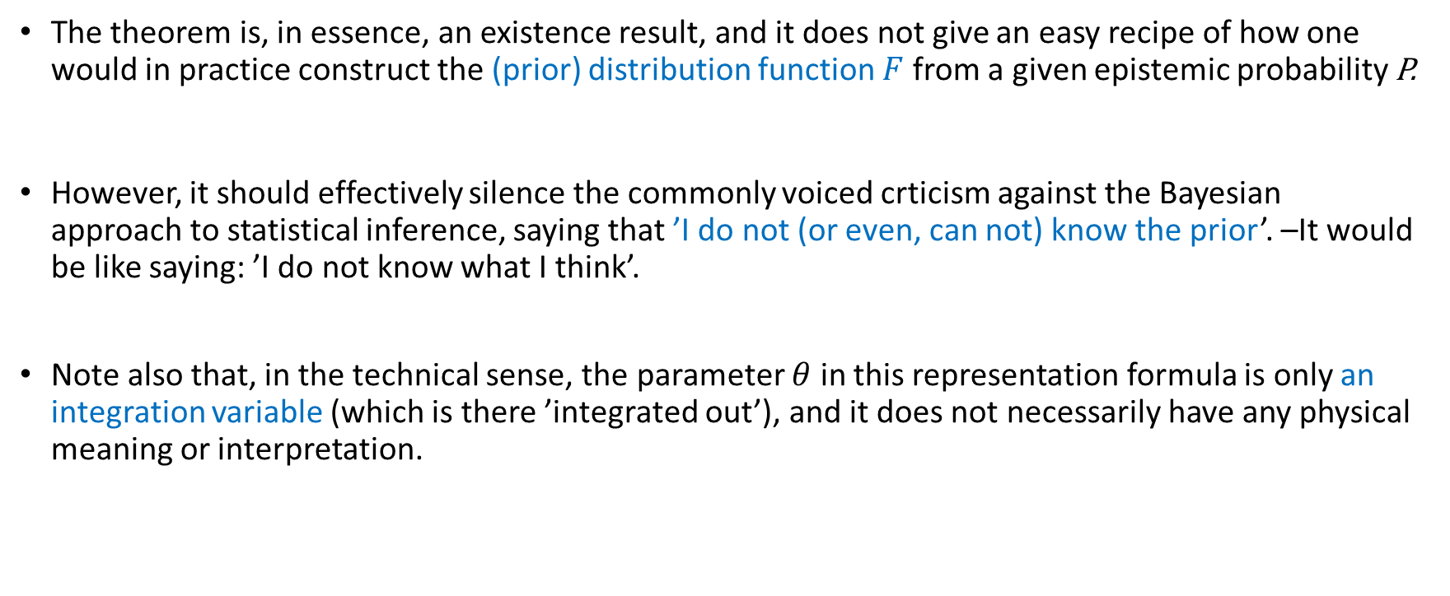
A drawing pin in a glass jar: Bayesian considerations
The theorem is, in essence, an existence result, and it does not give an easy recipe of how one would in practice construct the (prior) distribution function $F$ from a given epistemic probability P.
However, it should effectively silence the commonly voiced crticism against the Bayesian approach to statistical inference, saying that ’I do not (or even, can not) know the prior’. –It would be like saying: ’I do not know what I think’.
Note also that, in the technical sense, the parameter $θ$ in this representation formula is only an integration variable (which is there ’integrated out’), and it does not necessarily have any physical meaning or interpretation.

Slide 50
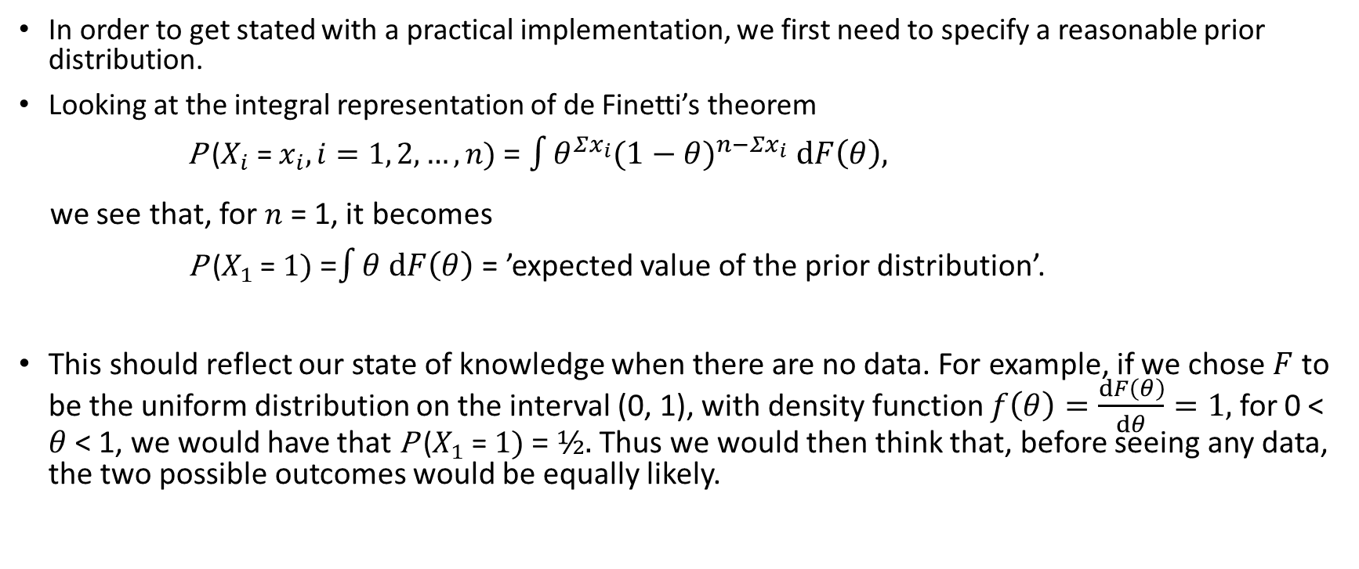
A drawing pin in a glass jar: practical implementation
In order to get stated with a practical implementation, we first need to specify a reasonable prior distribution.
Looking at the integral representation of de Finetti’s theorem
P ($X_{i}$ = $x_{i}, i=1, 2,…, n)$ = $\int{θ^{Σx_{i}}{(1−θ)}^{n−Σx_{i}} dF\left(θ\right),}$
we see that, for $n$ = 1, it becomes
P ($X_{1}$ = $1)$ =$\int{θ dF\left(θ\right) }$= ’expected value of the prior distribution’.
This should reflect our state of knowledge when there are no data. For example, if we chose $F$ to be the uniform distribution on the interval (0, 1), with density function $f\left(θ\right)=\frac{dF\left(θ\right)}{dθ}=1,$ for 0 < $θ$< 1, we would have that P ($X_{1}$ = $1)$ = ½. Thus we would then think that, before seeing any data, the two possible outcomes would be equally likely.

Slide 51
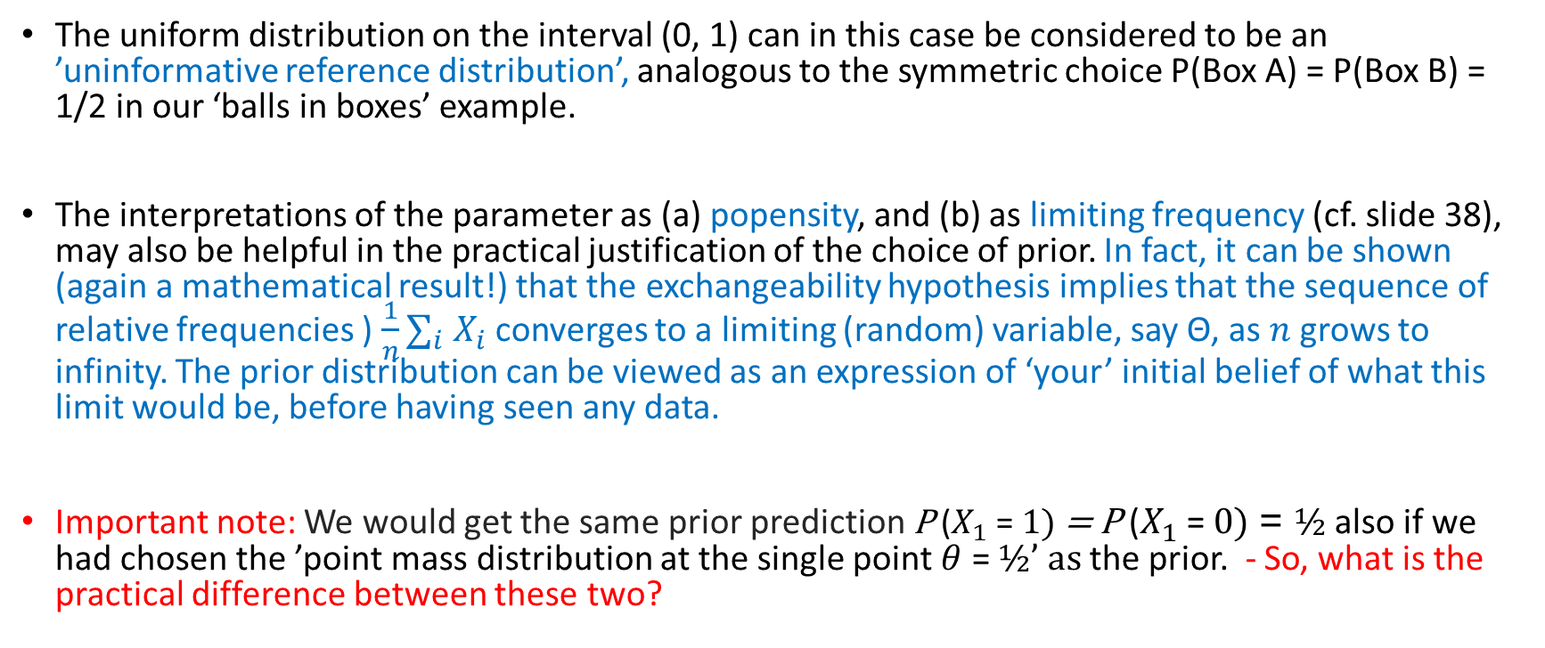
A drawing pin in a glass jar: practical implementation
The uniform distribution on the interval (0, 1) can in this case be considered to be an ’uninformative reference distribution’, analogous to the symmetric choice P(Box A) = P(Box B) = 1/2 in our ‘balls in boxes’ example.
The interpretations of the parameter as (a) popensity, and (b) as limiting frequency (cf. slide 38), may also be helpful in the practical justification of the choice of prior. In fact, it can be shown (again a mathematical result!) that the exchangeability hypothesis implies that the sequence of relative frequencies ) $\frac{1}{n}∑_{i} X_{i}$ converges to a limiting (random) variable, say Θ, as $n$grows to infinity. The prior distribution can be viewed as an expression of ‘your’ initial belief of what this limit would be, before having seen any data.
Important note: We would get the same prior prediction P ($X_{1}$ = $1)$ = P ($X_{1}$ = $0)$ = ½ also if we had chosen the ’point mass distribution at the single point $θ$ = ½’ as the prior. - So, what is the practical difference between these two?

Slide 52
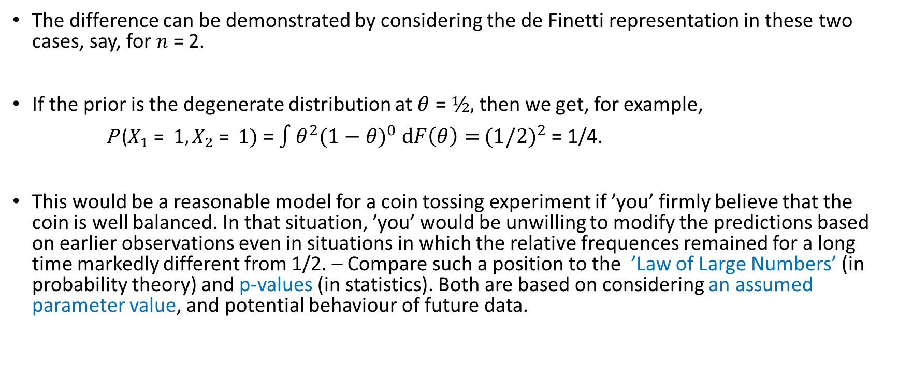
A drawing pin in a glass jar: practical implementation
The difference can be demonstrated by considering the de Finetti representation in these two cases, say, for $n$ = 2.
If the prior is the degenerate distribution at $θ$ = ½, then we get, for example,
P ($X_{1}$ = $1,X_{2}\text{ = } 1)$ = $\int{θ^{2}{(1−θ)}^{0} dF\left(θ\right)=}{(1/2)}^{2}$= 1/4.
This would be a reasonable model for a coin tossing experiment if ’you’ firmly believe that the coin is well balanced. In that situation, ’you’ would be unwilling to modify the predictions based on earlier observations even in situations in which the relative frequences remained for a long time markedly different from 1/2. – Compare such a position to the ’Law of Large Numbers’ (in probability theory) and p-values (in statistics). Both are based on considering an assumed parameter value, and potential behaviour of future data.

Slide 53
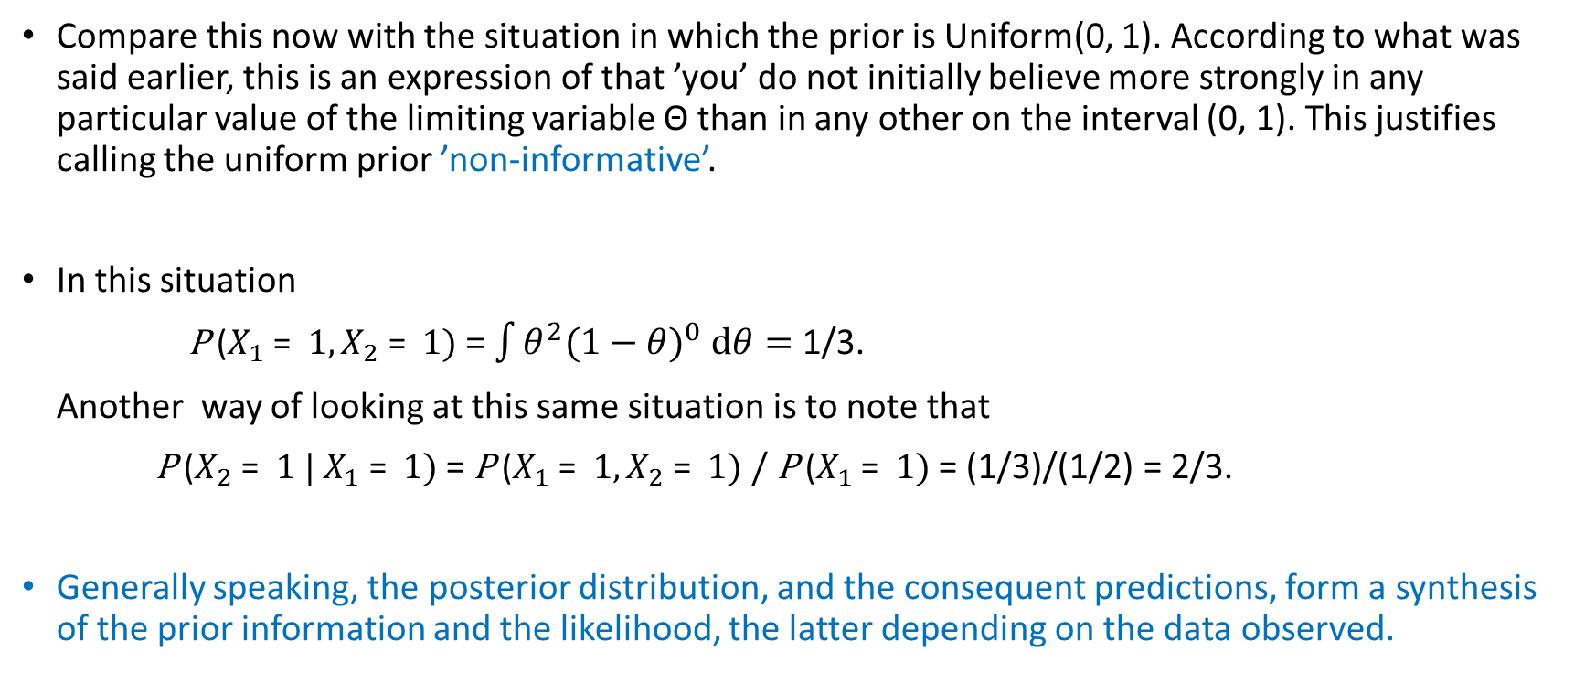
A drawing pin in a glass jar: practical implementation
Compare this now with the situation in which the prior is Uniform(0, 1). According to what was said earlier, this is an expression of that ’you’ do not initially believe more strongly in any particular value of the limiting variable Θ than in any other on the interval (0, 1). This justifies calling the uniform prior ’non-informative’.
In this situation
P ($X_{1}$ = $1,X_{2}\text{ = } 1)$ = $\int{θ^{2}{(1−θ)}^{0} dθ=}$ 1/3.
Another way of looking at this same situation is to note that
P ($X_{2}$ = $1 | X_{1}\text{ = } 1)$ = P ($X_{1}$ = $1,X_{2}\text{ = } 1)$ / P ($X_{1}$ = $1)$ = (1/3)/(1/2) = 2/3.
Generally speaking, the posterior distribution, and the consequent predictions, form a synthesis of the prior information and the likelihood, the latter depending on the data observed.

Slide 54
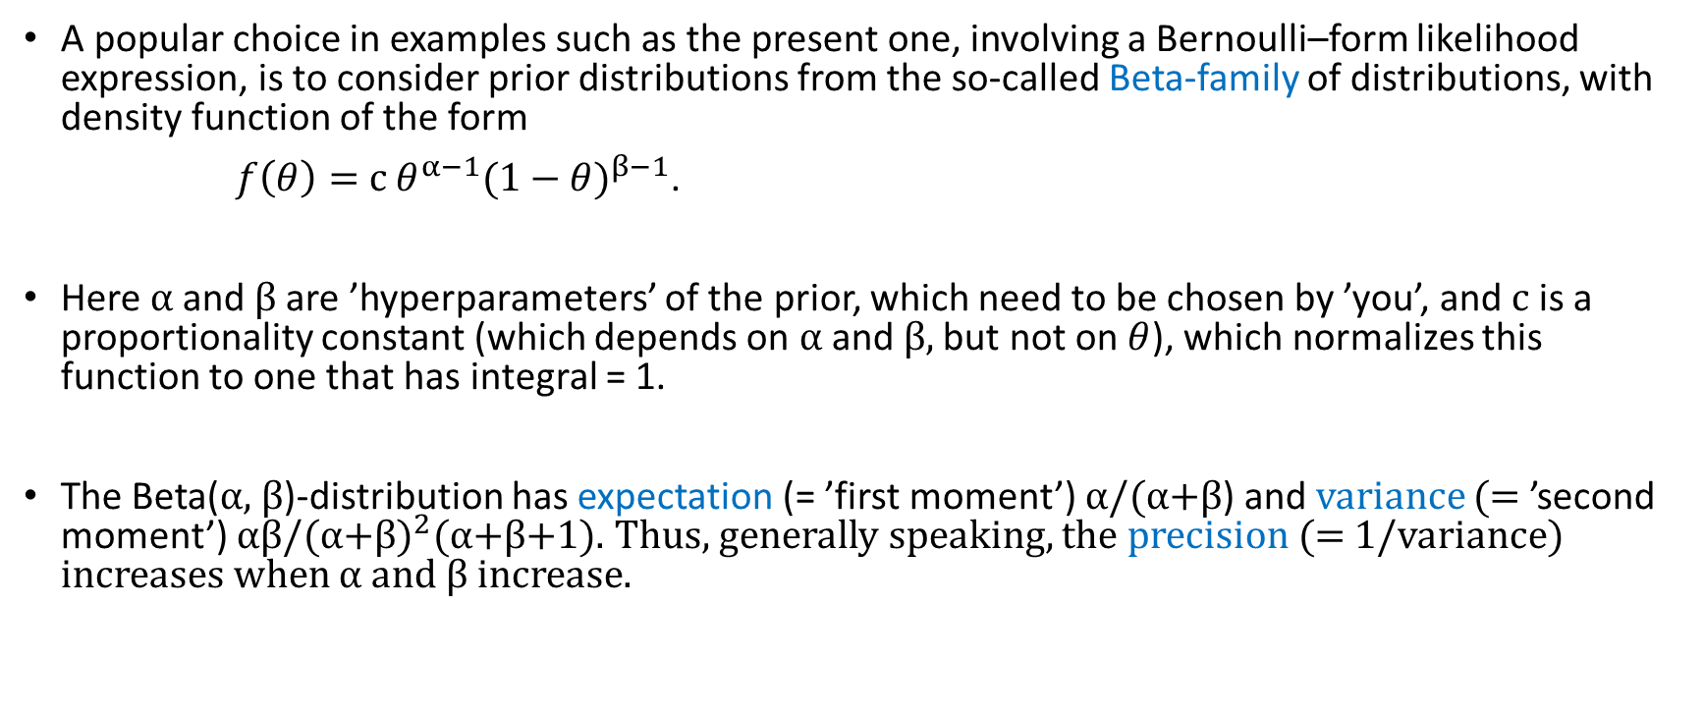
A drawing pin in a glass jar: practical implementation
A popular choice in examples such as the present one, involving a Bernoulli–form likelihood expression, is to consider prior distributions from the so-called Beta-family of distributions, with density function of the form
$f\left(θ\right)=$ c $θ^{α−1}{(1−θ)}^{β−1}$.
Here α and β are ’hyperparameters’ of the prior, which need to be chosen by ’you’, and c is a proportionality constant (which depends on α and β, but not on $θ$), which normalizes this function to one that has integral = 1.
The Beta(α, β)-distribution has expectation (= ’first moment’) α/(α+β) and variance (= ’second moment’) αβ/(α+β$)^{2}$(α+β+1). Thus, generally speaking, the precision (= 1/variance) increases when α and β increase.

Slide 55
A drawing pin in a glass jar: practical implementation
A particularly nice property of the Beta-family of priors is that, when combined with Bernoulli likelihoods, then also the posterior distribution belongs to the same Beta-family, with parameters updated by simple addition of hyperparameters and data.
Let’s verify this conjugacy property on the blackboard!

Slide 56
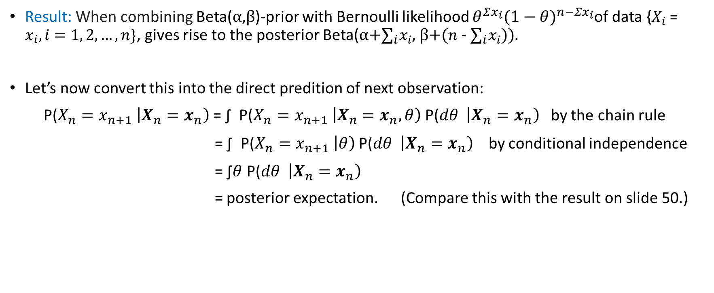
A drawing pin in a glass jar: practical implementation
Result: When combining Beta(α,β)-prior with Bernoulli likelihood $θ^{Σx_{i}}{(1−θ)}^{n−Σx_{i}}$of data {$X_{i}$ = $x_{i}, i=1, 2,…, n\}$, gives rise to the posterior Beta(α+$∑_{i}x_{i}$, β+($n$ - $∑_{i}x_{i}$)).
Let’s now convert this into the direct predition of next observation:
P(${X_{n}=x_{n+1}}_{ }\left|X_{n}=x_{n}\right)$ = ∫ P(${X_{n}=x_{n+1}}_{ }\left|X_{n}=x_{n},θ\right)$ P(${dθ }_{ }\left|X_{n}=x_{n}\right)$ by the chain rule
= ∫ P(${X_{n}=x_{n+1}}_{ }\left|θ\right)$ P(${dθ }_{ }\left|X_{n}=x_{n}\right)$ by conditional independence
= ∫$θ$ P(${dθ }_{ }\left|X_{n}=x_{n}\right)$
= posterior expectation. (Compare this with the result on slide 50.)

Slide 57
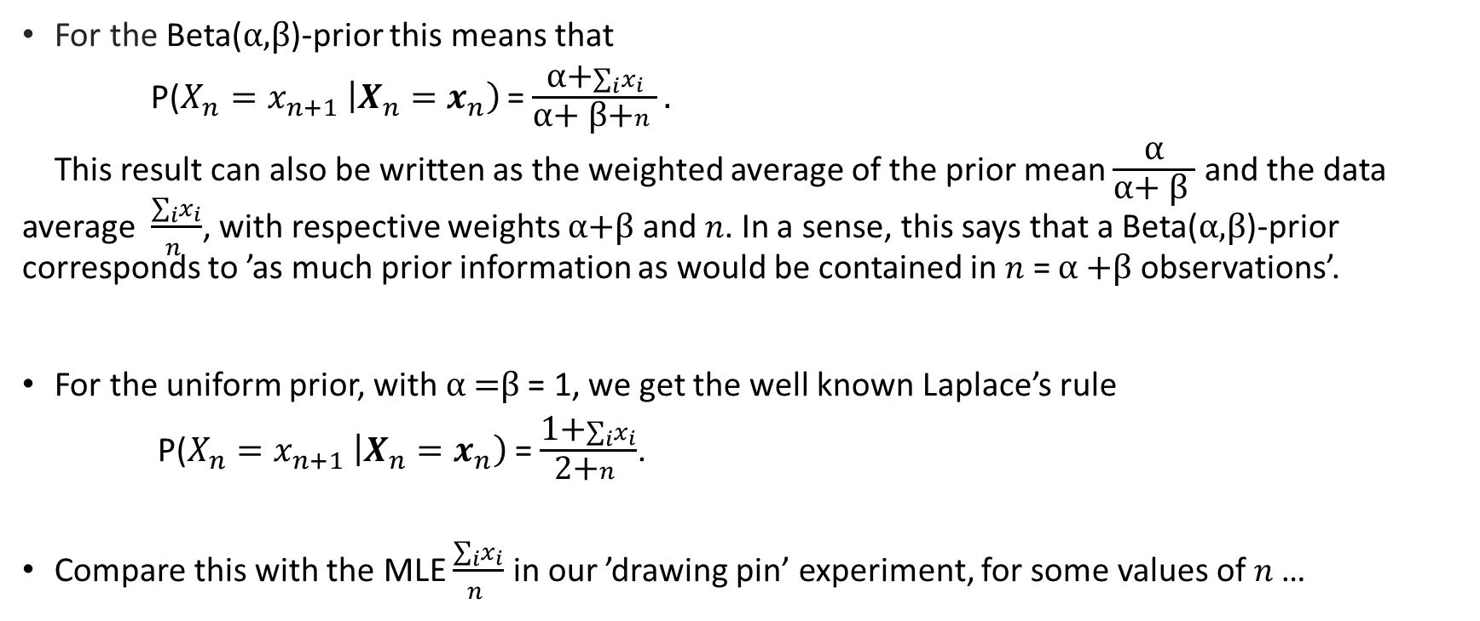
A drawing pin in a glass jar: practical implementation
For the Beta(α,β)-prior this means that
P(${X_{n}=x_{n+1}}_{ }\left|X_{n}=x_{n}\right)$ = $\frac{\text{α}\text{+}∑_{i}x_{i}}{\text{α}\text{+ }\text{β}\text{+}n }.$
This result can also be written as the weighted average of the prior mean $\frac{\text{α}}{\text{α}\text{+ }\text{β} }$ and the data average $\frac{∑_{i}x_{i}}{n }$, with respective weights α+β and $n$. In a sense, this says that a Beta(α,β)-prior corresponds to ’as much prior information as would be contained in $n$ = α +β observations’.
For the uniform prior, with α =β = 1, we get the well known Laplace’s rule
P(${X_{n}=x_{n+1}}_{ }\left|X_{n}=x_{n}\right)$ = $\frac{\text{1}\text{+}∑_{i}x_{i}}{\text{2}\text{+}n }$.
Compare this with the MLE $\frac{∑_{i}x_{i}}{n }$ in our ’drawing pin’ experiment, for some values of $n$…

Slide 58
Time permitting, and if there is interest …
… we could discuss further issues and possible problems relating to Bayesian inference, both in theory and practice.
A particular item could then be the commentary ’Higgs Boson – Digest and Discussion’, which can be downloaded from Tony O’Hagan’s home page http://www.tonyohagan.co.uk/academic

